Slide 1
Chapter 13
The Properties of Mixtures:
Solutions

Slide 2
REVIEW
Solution – any substance that is evenly dispersed or distributed throughout another substance.
A. homogeneous mixture – mixture in which the components are uniformly mixed and cannot be visually distinguished.
B. heterogeneous mixture – mixture characterized by observable segregation of component substances.
C. A solution contains both a solvent (dissolving medium) and solute (substance dissolved in the solvent).
D. Solid solutions with a metal as the solvent are called alloys. For example, solid brass is a mixture of Cu and Zn.

Slide 3
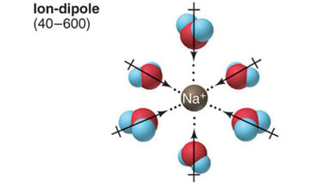
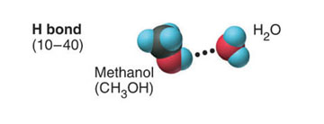
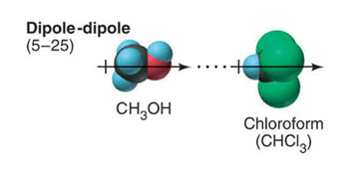
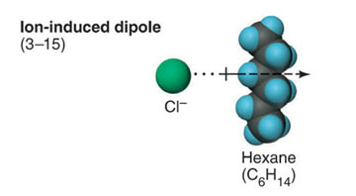
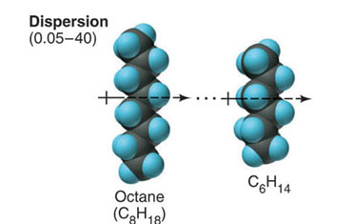
The major types of intermolecular forces in solutions.

Slide 4
LIKE DISSOLVES LIKE
Substances with similar types of intermolecular forces dissolve in each other.
When a solute dissolves in a solvent, solute-solute interactions and solvent-solvent interactions are being replaced with solute-solvent interactions. The forces must be comparable in strength in order to have a solution occur.

Slide 5
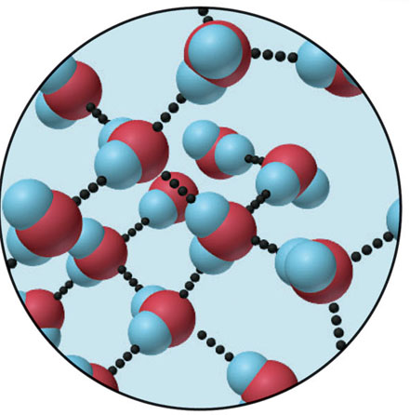
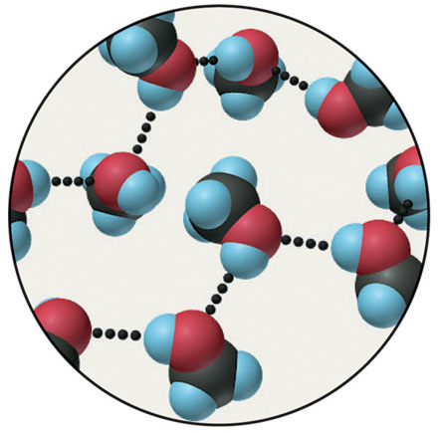
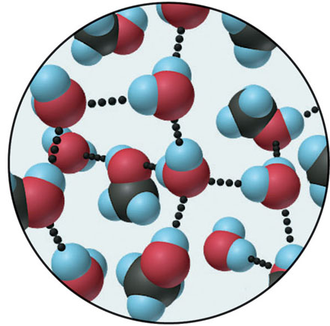
Like dissolves like: solubility of methanol in water.
water
methanol
A solution of methanol in water

Slide 6
SOLUTIONS
(HOMOGENEOUS MIXTURES)
Dissolution:
The attractive forces between Ions and water (ion-dipole) overcomes the lattice energy by solvation.
Solvation:
The clustering of solvent molecules around a solute molecule. If the solvent is H₂O also called hydration.
Factors: 1. Charge
2. Size
a. Lattice energy
b. Hydration energy

Slide 7
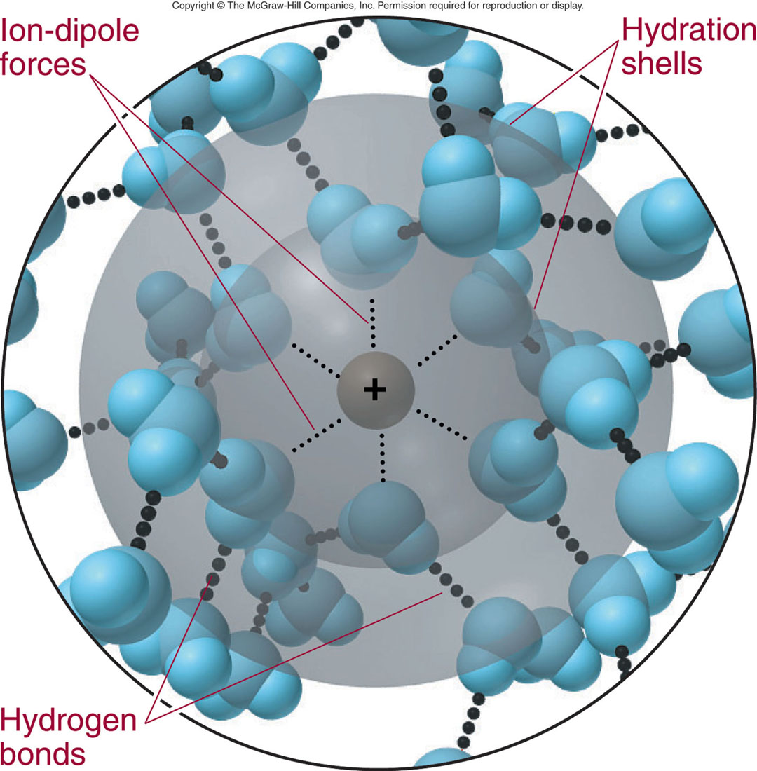
Hydration shells around an aqueous ion.

Slide 8
SOLUTIONS
Dissolving NaCl by H₂O
The attractive forces between Ions and H₂O (Ion-dipole force) overcomes the lattice energy by solvation.
Solvation ≡ the clustering of solvent
Molecules around a solute molecule if water is involved called hydration ≡ the clustering of H₂O molecule around a solute (Ion-Dipole force)

Slide 9
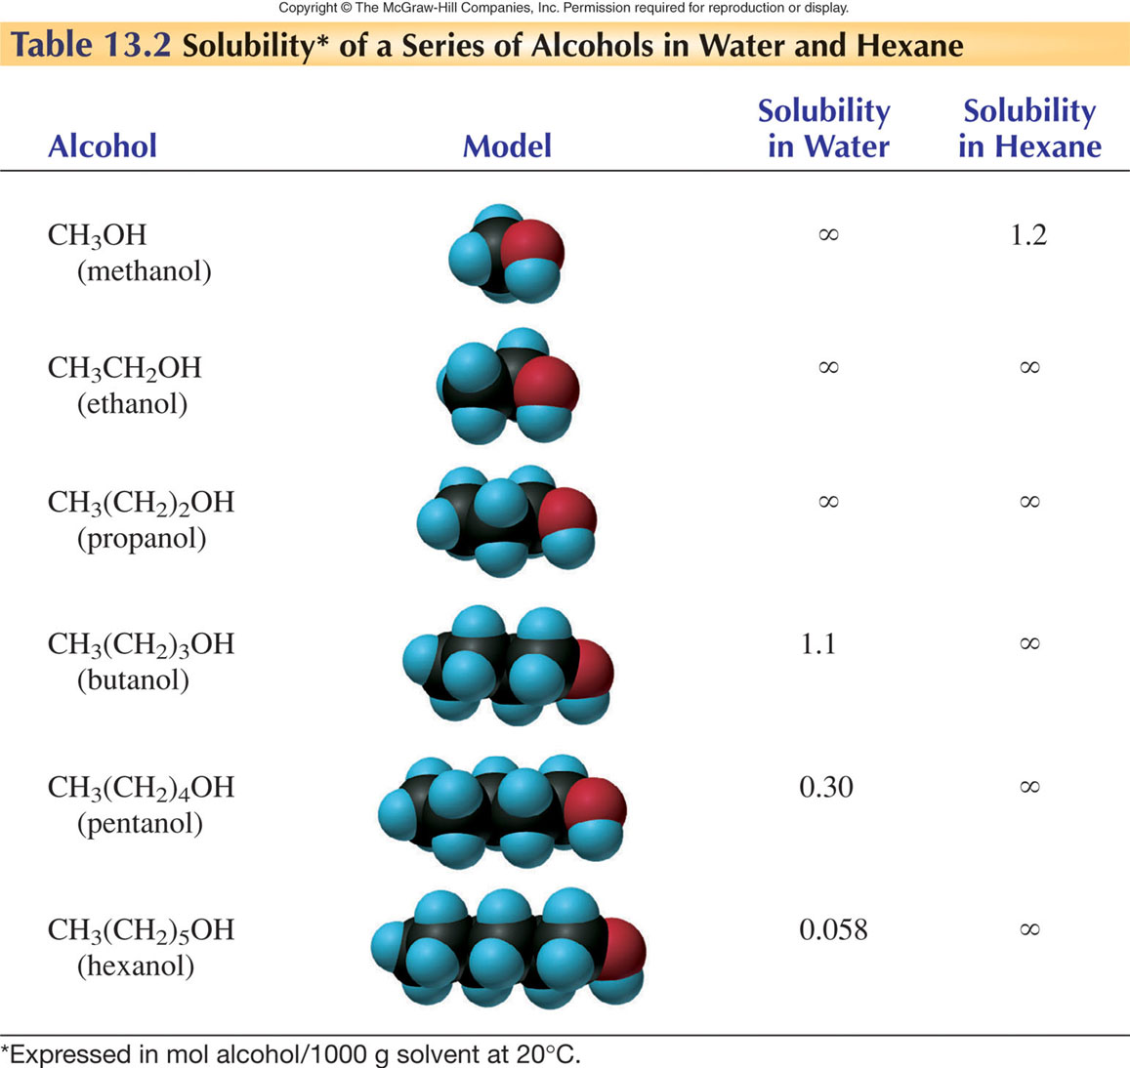

Slide 10
Solution Process
STEP 1: Separating the solute into its constituent particles

Slide 11
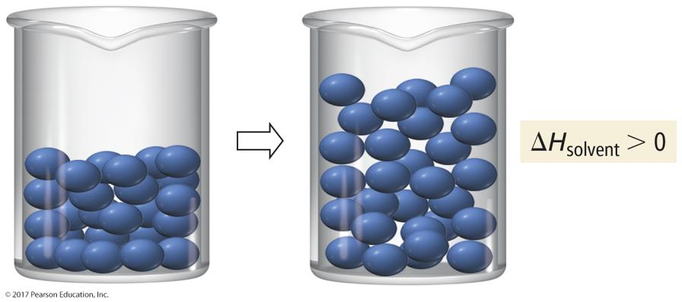
Solution Process
STEP 2: Separating the solvent particles from each other to make room for the solute particles

Slide 12
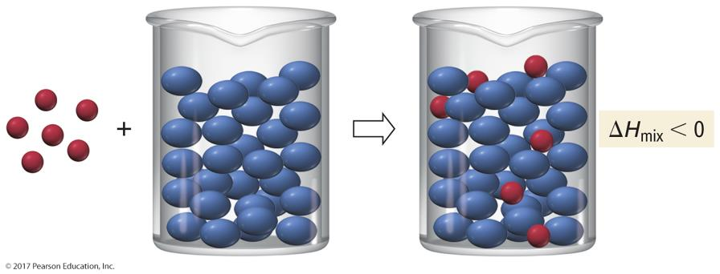
Solution Process
STEP 3: Mixing the solute particles with the solvent particles

Slide 13
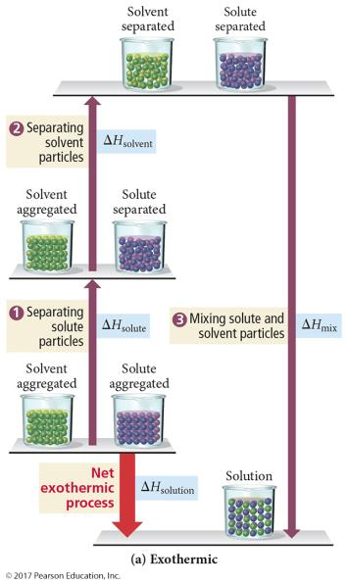
Energetics of Solution Formation
If the total energy cost for breaking attractions between particles in the pure solute and pure solvent is less than the energy released in making the new attractions between the solute and solvent, the overall process will be exothermic.

Slide 14
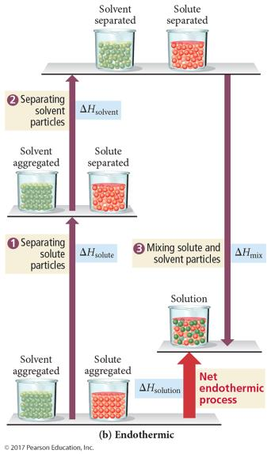
Energetics of Solution Formation
If the total energy cost for breaking attractions between particles in the pure solute and pure solvent is greater than the energy released in making the new attractions between the solute and solvent, the overall process will be endothermic.

Slide 15
Heats of Hydration
For aqueous solutions of ionic compounds, the energy added to overcome the attractions between water molecules and the energy released in forming attractions between the water molecules and ions is combined into a term called the heat of hydration.
Attractive forces between ions = lattice energy
ΔH_{solute} = −ΔH_{lattice energy}
Attractive forces in water = H bonds
Attractive forces between ion and water = ion–dipole
ΔH_{hydration} = heat released when one mole of gaseous ions dissolves in water = ΔH_{solvent} + ΔH_{mix}

Slide 16
Comparing Heat of Solution to Heat of Hydration
Because the lattice energy is always exothermic, the size and sign on the ΔH_{soln} tells us something about ΔH_{hydration}.
If the heat of solution is large and exothermic, then the amount of energy it costs to separate the ions is less than the energy released from hydrating the ions.
ΔH_{hydration} > ΔH_{solute} when ΔH_{soln} is (−).
If the heat of solution is large and endothermic, then the amount of energy it costs to separate the ions is more than the energy released from hydrating the ions.
ΔH_{hydration} < ΔH_{solute} when ΔH_{soln} is (+).

Slide 17
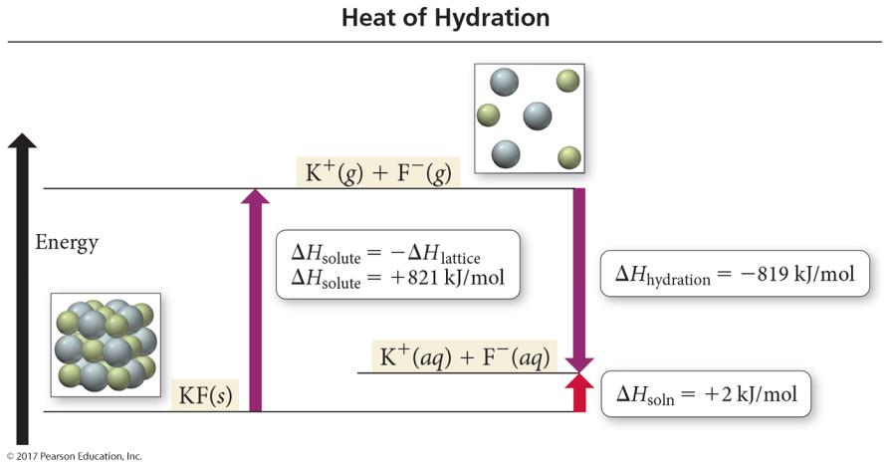
Heat of Hydration
ΔH_{solution} = ΔH_{hydration}− ΔH_{lattice energy}

Slide 18
Heats of Hydration
solvation of ions by water - always exothermic
H₂O
M⁺ (g) [or X⁻(g)] M⁺(aq) [or X⁻(aq)] ΔH_{hydr of the ion} < 0
ΔH_{hydr} is related to the charge density of the ion, that is, coulombic charge and size matter.
Lattice energy is the ΔH involved in the formation of an ionic solid from its gaseous ions.
M⁺ (g) + X⁻(g) MX(s) ΔH_{lattice} is always (-)

Slide 19
Heats of solution and solution cycles
1. Solute particles separate from each other - endothermic
solute (aggregated) + heat solute (separated) ΔH_{solute} > 0
2. Solvent particles separate from each other - endothermic
solvent (aggregated) + heat solvent (separated) ΔH_{solvent} > 0
3. Solute and solvent particles mix - exothermic
solute (separated) + solvent (separated) solution + heat ΔH_{mix} < 0
ΔH_{soln} = ΔH_{solute} + ΔH_{solvent} + ΔH_{mix}

Slide 20
Table 13.4 Trends in Ionic Heats of Hydration
Ion
Ionic Radius (pm)
ΔH_{hydr} (kJ/mol)
Group 1A(1)
Li⁺
76
-510
Na⁺
102
-410
K⁺
138
-336
Rb⁺
152
-315
Cs⁺
167
-282
Group 2A(2)
Mg²⁺
72
-1903
Ca²⁺
100
-1591
Sr²⁺
118
-1424
Ba²⁺
Group 7A(17)
F⁻
133
-431
Cl⁻
181
-313
Br⁻
196
-284
I⁻
220
-247

Slide 21
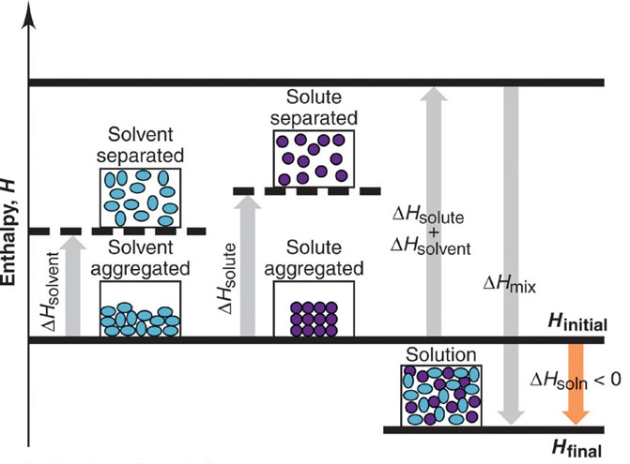
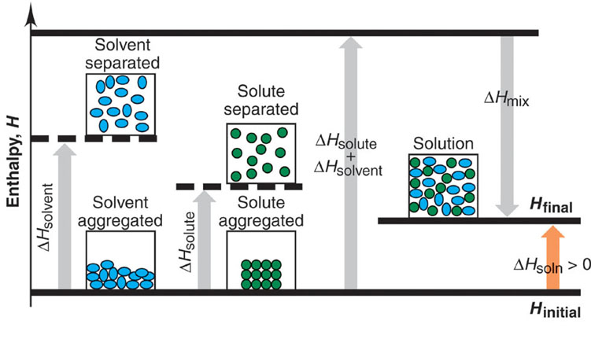
Solution cycles and the enthalpy components of the heat of solution.
Exothermic solution process
Endothermic solution process

Slide 22
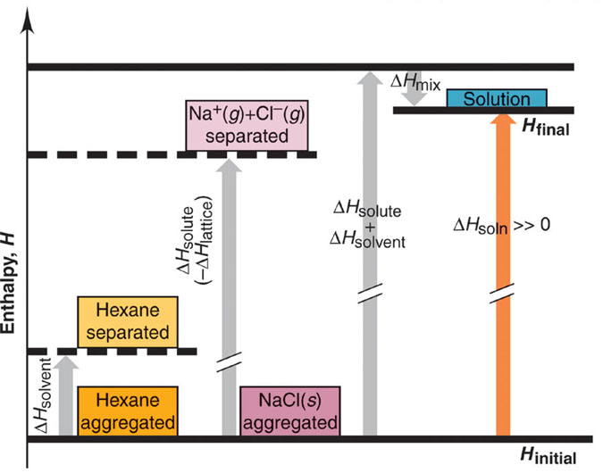
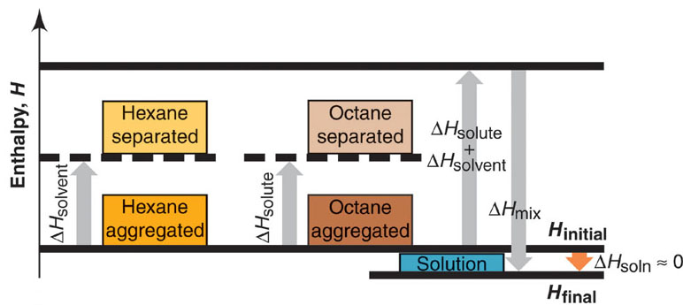
Enthalpy diagrams for dissolving NaCl and octane in hexane.

Slide 23
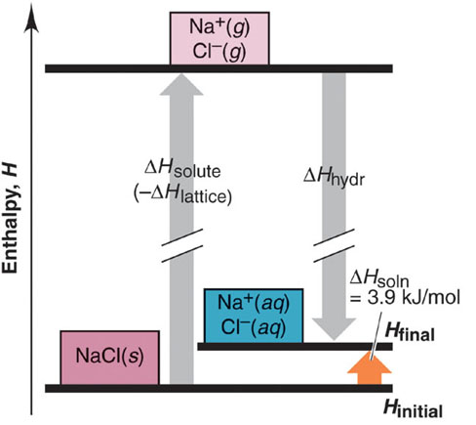
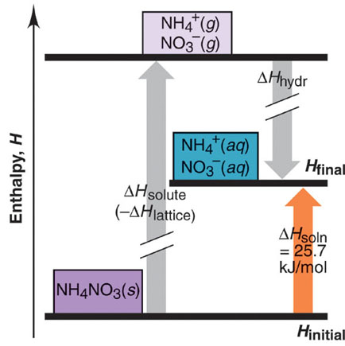
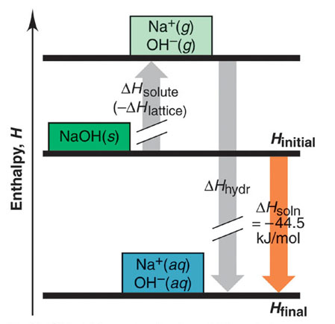
Dissolving ionic compounds in water.
NaCl
NH₄NO₃
NaOH

Slide 24
Solubility
A. A substance is said to be miscible when there is no apparent limit to the solubility of one substance in another. That is, if the intermolecular forces of attraction are of the same type and of equal strength, we predict that an ideal solution forms, and its enthalpy of solution (ΔH_{solution}) is very close to zero. That is, nearly ideal behavior is often observed when the solute-solute, solvent-solvent, and solute-solvent interactions are very much alike.
Example: pentane and hexane

Slide 25
B. Two liquids that do not mix are said to be immiscible or a nonideal solution. In this case, the two liquids mix endothermically, indicating that the solute-solvent interactions are weaker than the interactions among the molecules in the pure liquids. More energy is required to expand the liquids than is released when the liquids are mixed. Therefore, ΔH_{solution} is positive.
Example: pentane and H₂O
C. When a solute and solvent release large quantities of energy in the formation of a solution, that is when ΔH_{solution} is large and negative, one can assume that strong interactions exist between the solute and the solvent.
Example: acetone and H₂O

Slide 26
SOLUTIONS AND CONCENTRATION REVIEW
Qualitative: dilute vs concentrated
dilute = relatively small amount of solute in solvent
concentrated = relatively large amount of solute in solvent
Quantitative
solubility = amount of solute needed to form a saturated solution in a given solvent
saturated = a solution in equilibrium with undissolved solute. Additional solute will not dissolve
unsaturated = more solute needs to be added before reaching equilibrium saturation
supersaturated = solution containing more solute than saturated solution

Slide 27
Properties of solutions
“Like dissolves like” – if both solutions are nonpolar or if both solutions are significantly polar, solvation will occur.
1. Substances with similar intermolecular forces tend to be soluble in one another.
2. Nonpolar solvents tend to be insoluble in polar liquids.
II. A solution that cannot dissolve any more solute at a given temperature is said to be saturated. Referring to the equation above, when dissolution and crystallization occur at the same rate, the solution is in a state of dynamic equilibrium. The quantity of dissolved solute remains constant with time.

Slide 28
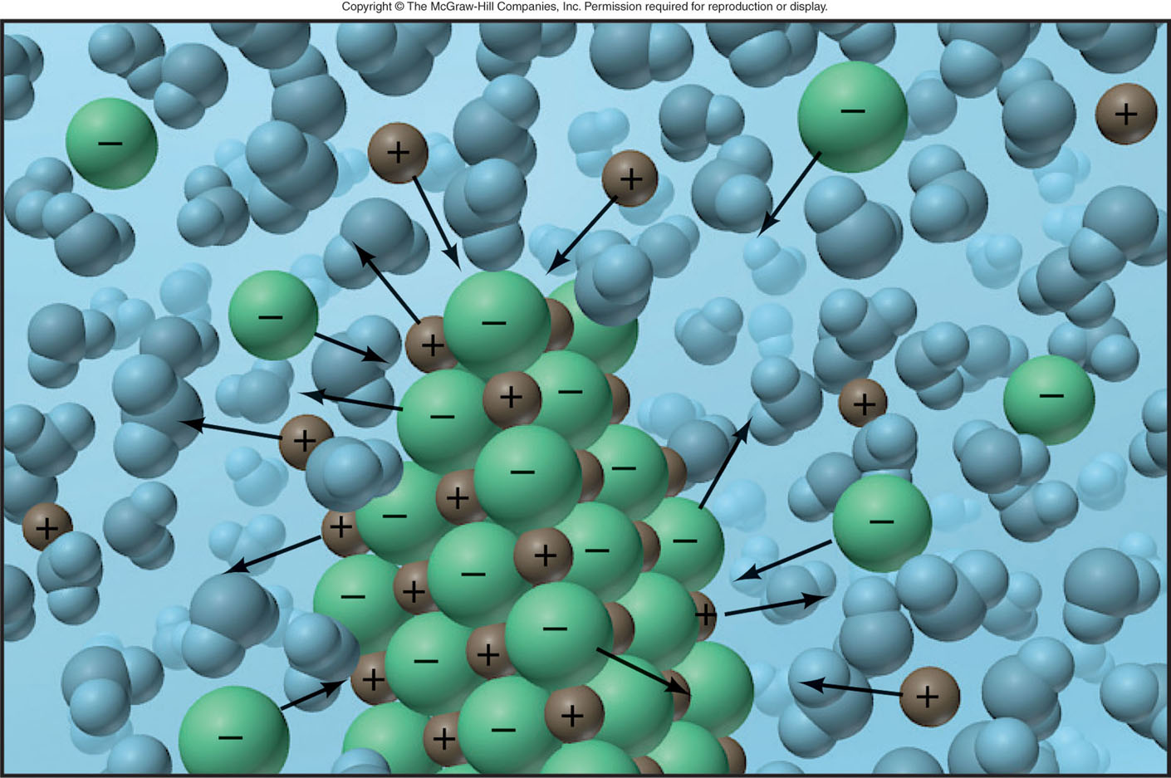
Equilibrium in a saturated solution.
solute (undissolved) solute (dissolved)

Slide 29
COMPARISON OF UNSATURATED AND
SATURATED SOLUTIONS
30.0 g NaCl + 100 mL H₂O = Unsaturated solution
containing 100mL H₂O
and 30.0 g NaCl
40.0 g NaCl + 100 mL H₂O = Saturated solution
containing 100 mL H₂O
and 36.0 g NaCl
The additional 4.0 g NaCl
remains undissolved

Slide 30
III. A solution that is able to dissolve more solute is called unsaturated.
VI. Under suitable conditions, it is sometimes possible to form solutions that contain a greater amount of solute than that needed to form a saturated solution. Such solutions are said to be supersaturated. Suppose we prepare a saturated solution at one temperature and then change the temperature to a value at which the solubility is lower (at a lower temperature). Usually, the excess solute crystallizes from solution, but occasionally all the solute may remain in solution.

Slide 31
Sodium acetate crystallizing from a supersaturated solution.

Slide 32
Question #1: Predict whether the substances listed below are more likely to dissolve in CCl₄ or H₂O. Explain your predictions.
A. C₇H₁₆ B. Na₂SO₄ C. HCl D. I₂
Question #2: Biochemical Application! Consider the structures of Vitamins A and C shown below. Which is more likely to be soluble in the fatty tissue of the body? Briefly explain.

Slide 33
FACTORS AFFECTING SOLUBILITY
I. Solute - solvent interactions
II. Temperature
III. Pressure
I. Solute/solvent interactions
A. Gas/liquid mixture
- solubility increases with increasing molecular
weight
B. Liquid/Liquid Mixture
- solubility depends on
1. Solute/solute interactions
2. Solvent/solvent interactions
3. Solute - solvent interactions
In general similar environment leads to miscibility.

Slide 34
Table 13.3
Correlation Between Boiling Point and Solubility in Water
Gas
Solubility (M)*
bp (K)
He
4.2 x 10⁻⁴
4.2
Ne
6.6 x 10⁻⁴
27.1
N₂
10.4 x 10⁻⁴
77.4
CO
15.6 x 10⁻⁴
81.6
O₂
21.8 x 10⁻⁴
90.2
NO
32.7 x 10⁻⁴
121.4
* At 273K and 1 atm

Slide 35
II. Temperature
Gas/Liquid mixture
- most gases are insoluble at higher
temperatures
Salt/Liquid mixture
- most salts become more soluble at high temperatures but many slightly soluble salts become insoluble.

Slide 36
Factors Affecting Solubility
II. Temperature
1.The solubility of most solid solutes in water increases with elevated temperatures. That is, solubility increases as temperature increases
2. In contrast to solid solutes, the solubility of gases decreases in water with increasing temperature (recall: increasing temperature = increase in Kinetic Energy = greater ease for gas molecules to escape from solution). For solutions of gases in organic solvents, the situation is often reversed; that is, gases become more soluble at higher temperatures.

Slide 37
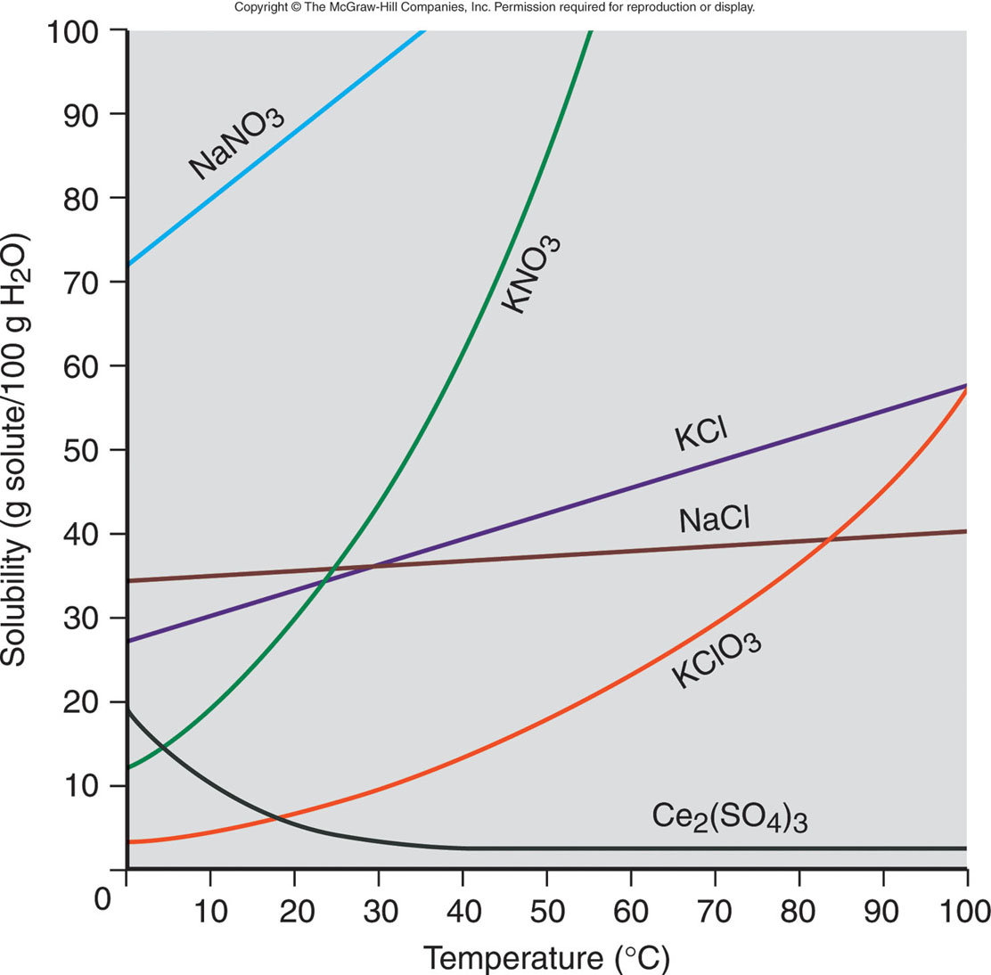
The relation between solubility and temperature for several ionic compounds.

Slide 38
PRESSURE EFFECTS
Henry’s Law
S_{gas} = k_{H} X P_{gas}
The solubility of a gas (S_{gas}) is directly proportional to the partial pressure of the gas (P_{gas}) above the solution.

Slide 39
III. Pressure
Gas/Liquid
- as P↑, the solubility↑
1. The solubility of a gas in any solvent is increased as the pressure of the gas over the solvent increases. Think about a freshly opened can of soda pop as it fizzes! Why does the soda go flat after time?
2. As more pressure is applied to gas molecules, the rate at which they strike the surface to enter the solution phase increases.
3. By contrast, the solubility's of solids and liquids are not appreciably affected by pressure.

Slide 40
III. Pressure
The solubility of a gas is directly proportional to its partial pressure. This observation was first observed by William Henry and is now known as Henry’s law:
S (solubility) = k P_{gas}
where k is called Henry’s constant (depends on the gas, solvent, and temperature), and P is the partial pressure of the gas. The solubility of a gas is proportional to its partial pressure because an increase in pressure corresponds to an increase in the rate at which gas molecules strike the surface of the solvent. Henry’s law fails for gases at extremely high pressures, and it also fails if the gas ionizes in water or reacts with water. We expect Henry’s law to apply only to equilibrium between molecules of a gas and the same molecules in solution.
This is an example of LeChatelier’s Principle - when a system is disturbed, the system shifts to counter act the change.

Slide 41
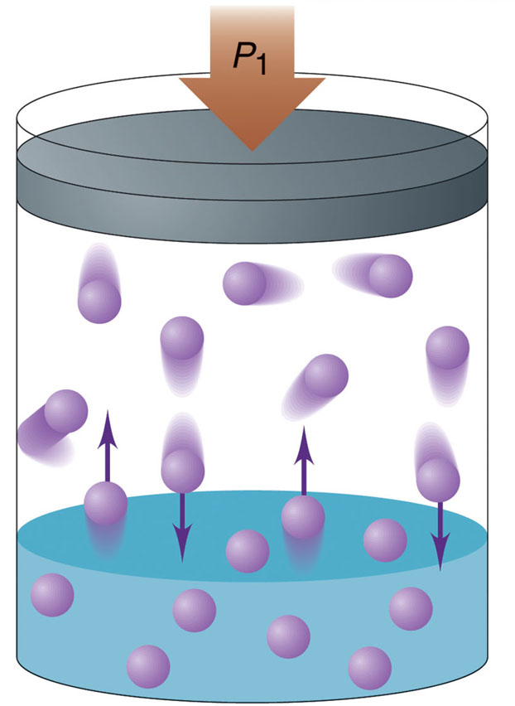
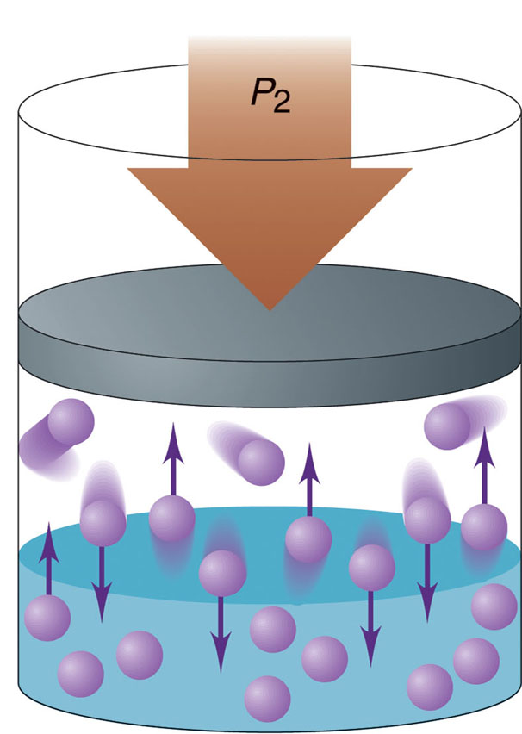
The effect of pressure on gas solubility.

Slide 42
HENRY’S LAW S = k_{H}P
Describes the solubility of a gas in a liquid.
S = solubility of gas mass of solute
volume of solvent
k_{H} = constant for liquid at specific T
P = partial pressure of gas
Q - He/O₂ mixtures are sometimes used as breathing gas in
deep sea diving. At sea level (1 atm) the solubility of pure
He in blood is 0.94g per 100 mL. What is the solubility
of pure He at a depth of 1500 ft?
(Pressure increases by 1 atm/33 ft. in depth∴ 1500 ft = 45 atm)

Slide 43
Expressing Solution Concentration

Slide 44
Solution Concentration
Earlier we learned about one method for expressing solution concentration—molarity. We defined molarity as moles of solute/liters of solution. Now we will describe several other methods of expressing concentration, each of which serves a different purpose.
A. mass percentage
Mass % of component =
B. parts per million (for dilute solutions)
ppm of component =
C. parts per billion (for even MORE dilute solutions!)
ppb of component =

Slide 45
D. mole fraction (denoted with the symbol χ)
Mole fraction of component =
E. molality (denoted with the lowercase letter m)
molality =
The molality of a given solution does NOT vary with temperature because masses do not vary with temperature. Molarity, however, changes with temperature because the expansion or contraction of the solution changes its volume. Thus, molality is often the concentration unit of choice when a solution is to be used over a range of temperatures.

Slide 46
1. When Potassium dichromate (s) is added to excess concentrated HCl, it reacts to produce a mixture of Chromium (III) chloride, Potassium Chloride, and evolved Cl₂ gas. Suppose 6.25 g of potassium dichromate reacts with concentrated HCl to produce a final volume of 100mL. Calculate the [Cr³⁺]_{f} and the moles of gas produced.
2. The density of toluene, C₇H₈, is 0.867 g/mL and the density of thiophene, C₄H₄S, is 1.065 g/mL. A solution is made by dissolving 15.0 g of thiophene in 250 mL of toluene.
A. Calculate the mole fraction
B. Calculate the molarity
C. Calculate the molality
D. Is it better to express this solution by mass % or ppm?

Slide 47
Workshop on Concentration
1. A solution of hydrochloric acid contains 36% HCl by mass.
A. Calculate the mole fraction of HCl in the solution.
B. Calculate the molality of HCl in the solution.
2. A solution contains 5.0 g of toluene (C₇H₈) and 225 g of benzene and has a density of 0.876 g/mL. Calculate the molarity of the solution.
3. Calculate the mol of CO₂ that will dissolve in enough water to form 900 mL of solution at 20 °C if the partial pressure of CO₂ is 1.00 atm. NOTE: k for CO₂ in water at 20 °C = 2.3 x 10⁻² mol L⁻¹atm⁻¹

