Slide 1
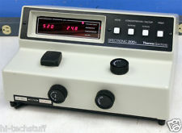
SPECTROSCOPY & Beer-Lambert Law
Chemistry 101

Slide 2
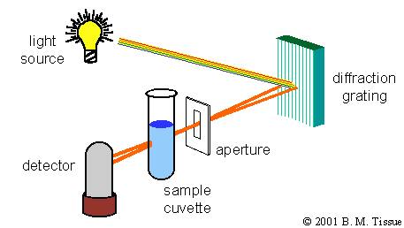
When visible white light strikes a substance, the substance may (1) reflect the light if it is opaque,
(2) transmit the light if it is transparent to the light striking it, or (3) absorb the light.
Substances absorb light by changing their electronic & vibrational quantum states or modes. These modes, which are related to harmonic variations of bond lengths and angles and electronic configurations, have energies on the order of ultraviolet and visible (UV-vis) light.
SPECTROSCOPY is the study of
Light energy interactions with
Matter. To the right is a simple
Spectrophotometer.

Slide 4
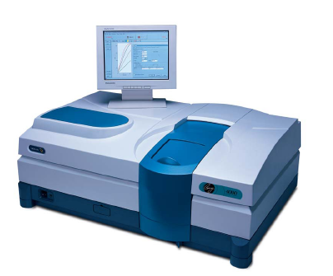
UV/Visible Spectroscopy: Instrumentation
In absorption spectroscopy, we measure ε as a function of wavelength λ
The instrument we use to do this is called a UV/visible Spectrophotometer
The Major Components Are:
A light source
A monochromator
A Sample Compartment
A detector

Slide 5
Interaction of light with matter
Definition of absorbance & transmittance
I_{in}
I_{out}
s
Absorbance
Transmittance
Absorbance (A) and transmittance (T) are unitless

Slide 6
Wavelength of maximum absorption, λ_{max}
Graph #1
λ_{max}=740 nm
CuSO₄(aq) is a light blue solution, notice location of the absorption peaks.

Slide 7
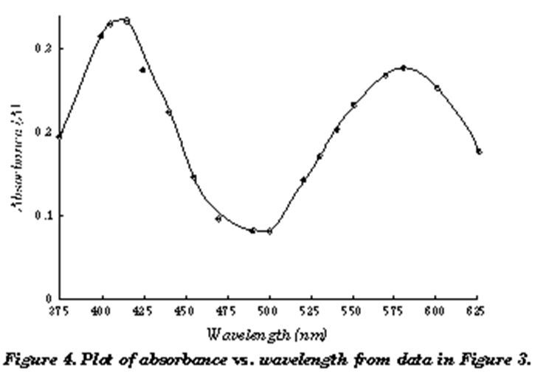
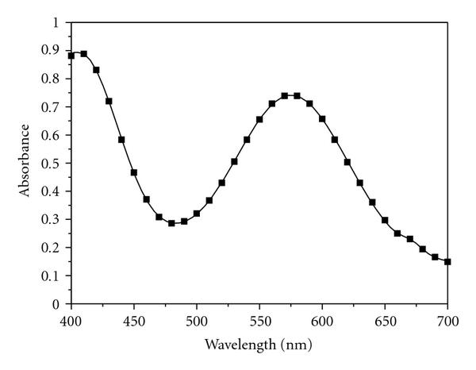
In part one of the experiment, you will use the spectrophotometer to determine the absorbance spectrum of KMnO₄ solution.
Based on the spectra, you will determine the maximum (peak) wavelength. This wavelength, λ_{max}, will be used in part two of the experiment

Slide 8
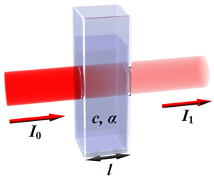

Slide 9
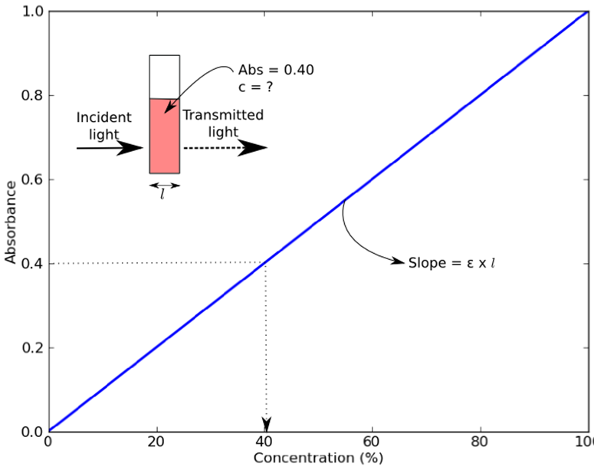
If light is absorbed by the sample, the intensity of the transmitted light exiting the sample (I) will be less than the intensity of the incident light (I_{o}). The ratio of transmitted light intensity to the incident light intensity is the transmittance, T:

Slide 10
When making solutions
500 mL mark
500mL
500mL
Volumetric
flask
Erlenmeyer
flask
Beaker
Very accurate
less accurate
not accurate

Slide 12
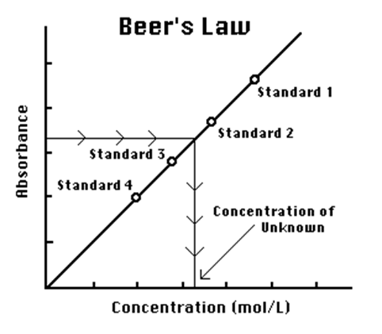
Calibration Curve

Slide 13
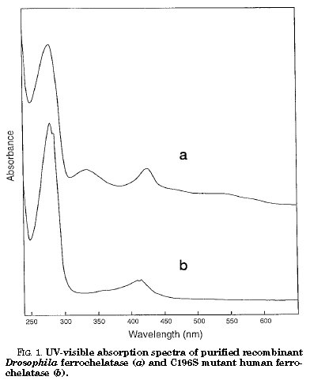
UV/Visible Applications
This paper looks at iron-sulfur clusters in a native and a mutant protein
C196S Mutant lacks broad absorption band between 400-600 nm which is diagnostic of an 2Fe-2S cluster
JBC (1998)Vol. 273, No. 35;28 pp. 22311–22316

Slide 14
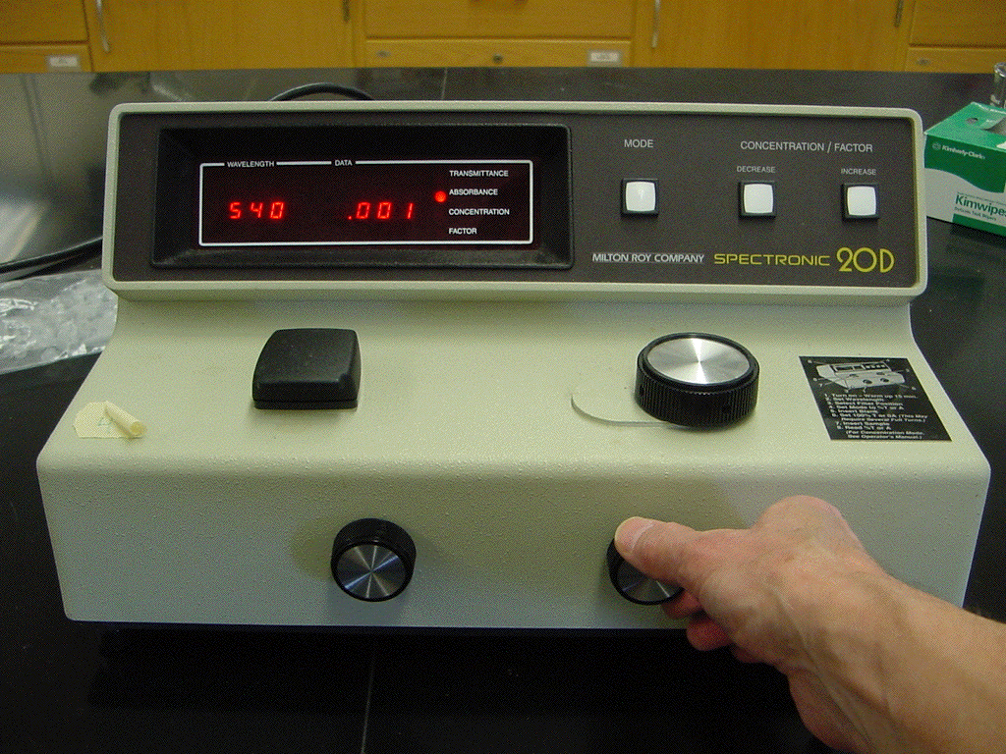

Slide 15
I. How to use the spectrophotometer (Spec 20/20D)
1. Turn on the instrument and let it warm up for at least 5-10 minutes.
2. Select the wavelength with the dial next to the sample compartment.
3. With the sample compartment closed and empty, adjust the % Transmittance (zero percent transmission of light) to read 0% T using the left front dial.
4. Place a clean (no fingerprints), dry cuvette filled approximately 3/4 full of the blank sample (solvent only) in the sample compartment. Close the sample compartment. Adjust the % Transmittance to read 100% T (100 percent transmission of light) using the right front dial.
5. Remove the blank cuvette and place the cuvette containing the sample in the sample compartment. Close the sample compartment. Read and record the value registered on the meter.
Note: Every time the wavelength of light is changed, the instrument must be recalibrated to read 0% T and 100% T with the blank. Repeat steps 2-5.

