Slide 1
Sample Exercise 16.1 Identifying Conjugate Acids and Bases
(a) What is the conjugate base of HClO₄, H₂S, PH₄⁺, HCO₃–?
(b) What is the conjugate acid of CN–, SO₄^{2–}, H₂O, HCO₃–?
Solution
Analyze We are asked to give the conjugate base for several acids and the conjugate acid for several bases.
Plan The conjugate base of a substance is simply the parent substance minus one proton, and the conjugate acid of a substance is the parent substance plus one proton.
Solve
(a) If we remove a proton from HClO₄, we obtain ClO₄–, which is its conjugate base. The other conjugate bases are HS–, PH₃, and CO₃^{2–}.
(b) If we add a proton to CN– , we get HCN, its conjugate acid. The other conjugate acids are HSO₄–, H₃O⁺, and H₂CO₃. Notice that the hydrogen carbonate ion (HCO₃–) is amphiprotic. It can act as either an acid or a base.
Practice Exercise 1
Consider the following equilibrium reaction:
HSO₄– (aq) + OH–(aq) SO₄^{2–} (aq) + H₂O(l)

Slide 2
Sample Exercise 16.1 Identifying Conjugate Acids and Bases
Continued
Which substances are acting as acids in the reaction?
(a) HSO₄– and OH–
(b) HSO₄– and H₂O
(c) OH– and SO₄^{2–}
(d) SO₄^{2–} and H₂O
(e) None of the substances are acting as acids in this reaction.
Practice Exercise 2
Write the formula for the conjugate acid of each of the following: HSO₃–, F–, PO₄^{3–}, CO.

Slide 3
Sample Exercise 16.2 Writing Equations for Proton-Transfer Reactions
The hydrogen sulfite ion (HSO₃–) is amphiprotic. Write an equation for the reaction of HSO₃– with water (a) in which the ion acts as an acid and (b) in which the ion acts as a base. In both cases identify the conjugate acid–base pairs.
Solution
Analyze and Plan We are asked to write two equations representing reactions between HSO₃– and water, one in which HSO₃– should donate a proton to water, thereby acting as a Brønsted–Lowry acid, and one in which HSO₃– should accept a proton from water, thereby acting as a base. We are also asked to identify the conjugate pairs in each equation.
Solve
(a) HSO₃–(aq) + H₂O(l) SO₃^{2–}(aq) + H₃O⁺(aq)
The conjugate pairs in this equation are HSO₃– (acid) and SO₃^{2–} (conjugate base), and H₂O (base) and H₃O⁺ (conjugate acid).
(b) HSO₃–(aq) + H₂O(l) H₂SO₃(aq) + OH– (aq)
The conjugate pairs in this equation are H₂O (acid) and OH– (conjugate base), and HSO₃– (base) and H₂SO₃ (conjugate acid).
Practice Exercise 1
The dihydrogen phosphate ion, H₂PO₄–, is amphiprotic.
In which of the following reactions is this ion serving as a base?
(i) H₃O⁺(aq) + H₂PO₄–(aq) H₃PO₄(aq) + H₂O(l)
(ii) H₃O⁺(aq) + HPO₄^{2–}(aq) H₂PO₄–(aq) + H₂O(l)
(iii) H₃PO₄(aq) + HPO₄^{2–}(aq) 2 H₂PO₄–(aq)
(a) i only (b) i and ii (c) i and iii (d) ii and iii (e) i, ii, and iii

Slide 4
Sample Exercise 16.2 Writing Equations for Proton-Transfer Reactions
Continued
Practice Exercise 2
When lithium oxide (Li₂O) is dissolved in water, the solution turns basic from the reaction of the oxide ion (O^{2–}) with water. Write the equation for this reaction and identify the conjugate acid–base pairs.

Slide 5
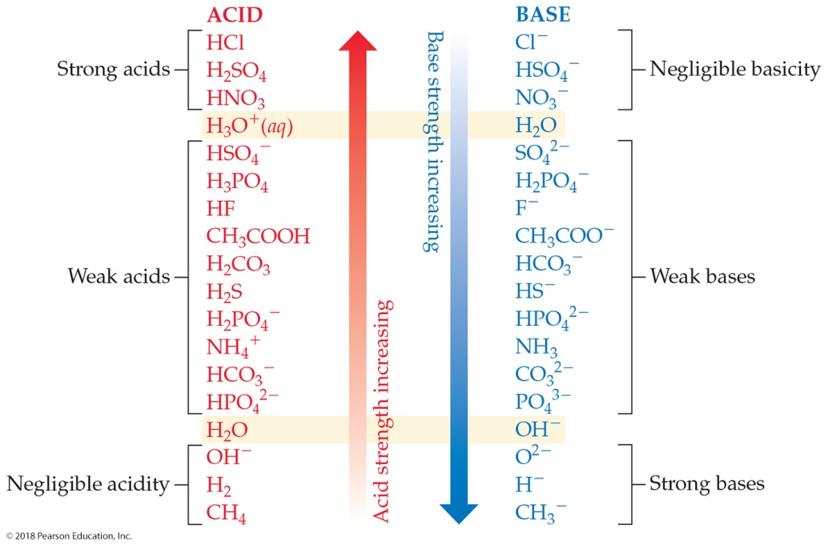
Sample Exercise 16.3 Predicting the Position of a Proton-Transfer Equilibrium
For the following proton-transfer reaction, use Figure 16.4 to predict whether the equilibrium lies to the left (K_{c} < 1) or to the right (K_{c} > 1):
HSO₄–(aq) + CO₃^{2–}(aq) SO₄^{2–}(aq) + HCO₃–(aq)
Solution
Analyze We are asked to predict whether an equilibrium lies to the right, favoring products, or to the left, favoring reactants.
Plan This is a proton-transfer reaction, and the position of the equilibrium will favor the proton going to the stronger of two bases. The two bases in the equation are CO₃^{2–}, the base in the forward reaction, and SO₄^{2–}, the conjugate base of HSO₄–. We can find the relative positions of these two bases in Figure 16.4 to determine which is the stronger base.

Slide 6
Sample Exercise 16.3 Predicting the Position of a Proton-Transfer Equilibrium
Continued
Solve The CO₃^{2–} ion appears lower in the right-hand column in Figure 16.4 and is therefore a stronger base than SO₄^{2–}. Therefore, CO₃^{2–} will get the proton preferentially to become HCO₃–, while SO₄^{2–} will remain mostly unprotonated. The resulting equilibrium lies to the right, favoring products (that is, K_{c} > 1):
HSO₄–(aq) + CO₃^{2–}(aq) SO₄^{2–}(aq) + HCO₃–(aq) K_{c} > 1
Comment Of the two acids HSO₄– and HCO₃–, the stronger one (HSO₄–) gives up a proton more readily, and the weaker one (HCO₃–) tends to retain its proton. Thus, the equilibrium favors the direction in which the proton moves from the stronger acid and becomes bonded to the stronger base.
Practice Exercise 1
Based on information in Figure 16.4, place the following equilibria in order from smallest to largest value of K_{c}:
(i) CH₃COOH(aq) + HS–(aq) CH₃COO–(aq) + H₂S(aq)
(ii) F–(aq) + NH₄⁺(aq) HF(aq) + NH₃(aq)
(iii) H₂CO₃(aq) + Cl– (aq) HCO₃–(aq) + HCl(aq)
(a) i < ii < iii (b) ii < i < iii (c) iii < i < ii (d) ii < iii < i (e) iii < ii < i
Acid
Base
Conjugate base
Conjugate acid

Slide 7
Sample Exercise 16.3 Predicting the Position of a Proton-Transfer Equilibrium
Continued
Practice Exercise 2
For each reaction, use Figure 16.4 to predict whether the equilibrium lies to the left or to the right:
(a) HPO₄^{2–}(aq) + H₂O(l) H₂PO₄–(aq) + OH–(aq)
(b) NH₄⁺(aq) + OH–(aq) NH₃(aq) + H₂O(l)

Slide 8
Sample Exercise 16.4 Calculating [H⁺] for Pure Water
Calculate the values of [H⁺] and [OH–] in a neutral aqueous solution at 25 °C.
Solution
Analyze We are asked to determine the concentrations of H⁺ and OH– ions in a neutral solution at 25 °C.
Plan We will use Equation 16.16 and the fact that, by definition, [H⁺] = [OH–] in a neutral solution.
Solve We will represent the concentration of H⁺ and OH– in neutral solution with x. This gives
In an acid solution [H⁺] is greater than 1.0 × 10^{–7} M; in a basic solution [H⁺] is less than 1.0 × 10^{–7} M.
Practice Exercise 1
In a certain acidic solution at 25 °C, [H⁺] is 100 times greater than [OH–]. What is the value for [OH–] for the solution?
(a) 1.0 × 10^{–8} M (b) 1.0 × 10^{–7} M (c) 1.0 × 10^{–6} M
(d) 1.0 × 10^{–2} M (e) 1.0 × 10^{–9} M

Slide 9
Sample Exercise 16.4 Calculating [H⁺] for Pure Water
Continued
Practice Exercise 2
Indicate whether solutions with each of the following ion concentrations are neutral, acidic, or basic at 25 °C:
(a) [H⁺] = 4 × 10^{–9} M;
(b) [OH–] = 1 × 10^{–7} M;
(c) [OH–] = 1 × 10^{–13} M.

Slide 10
Sample Exercise 16.5 Calculating [H⁺] from [OH–]
Calculate the concentration of H⁺(aq) in (a) a solution in which [OH–] is 0.010 M, (b) a solution in which [OH–] is 1.8 × 10^{–9} M. Note: In this problem and all that follow, we assume, unless stated otherwise, that the temperature is 25 °C.
Solution
Analyze We are asked to calculate the [H⁺] concentration in an aqueous solution where the hydroxide concentration is known.
Plan We can use the equilibrium-constant expression for the autoionization of water and the value of K_{w} to solve for each unknown concentration.
Solve
(a) Using Equation 16.16, we have
This solution is basic because
[OH–] > [H⁺]

Slide 11
Sample Exercise 16.5 Calculating [H⁺] from [OH–]
Continued
(b) In this instance
This solution is acidic because
[H⁺] > [OH–]
Practice Exercise 1
A solution has [OH–] = 4.0 × 10^{–8}. What is the value of [H⁺] for the solution?
(a) 2.5 × 10^{–8} M (b) 4.0 × 10^{–8} M (c) 2.5 × 10^{–7} M
(d) 2.5 × 10^{–6} M (e) 4.0 × 10^{–6} M
Practice Exercise 2
Calculate the concentration of OH–(aq) in a solution in which
(a) [H⁺] = 2 × 10^{–6} M; (b) [H⁺] = [OH–];
(c) [H⁺] = 200 × [OH–].

Slide 12
Sample Exercise 16.6 Calculating pH from [H⁺]
Calculate the pH values for the two solutions of Sample Exercise 16.5.
Solution
Analyze We are asked to determine the pH of aqueous solutions for which we have already calculated [H⁺].
Plan We can calculate pH using its defining equation, Equation 16.17.
Solve
(a) In the first instance we found [H⁺] to be 1.0 × 10^{–12} M, so that
pH = –log(1.0 × 10^{–12}) = –(–12.00) = 12.00
Because 1.0 × 10^{–12} has two significant figures, the pH has two decimal places, 12.00.
(b) For the second solution, [H⁺] = 5.6 × 10^{–6} M. Before performing the calculation, it is helpful to estimate the pH. To do so, we note that [H⁺] lies between 1 × 10^{–6} and 1 × 10^{–5}. Thus, we expect the pH to lie between 6.0 and 5.0. We use Equation 16.17 to calculate the pH:
pH = –log(5.6 × 10^{–6}) = 5.25
Check After calculating a pH, it is useful to compare it to your estimate. In this case the pH, as we predicted, falls between 6 and 5. Had the calculated pH and the estimate not agreed, we should have reconsidered our calculation or estimate or both.

Slide 13
Sample Exercise 16.6 Calculating pH from [H⁺]
Continued
Practice Exercise 1
A solution at 25 °C has [OH–] = 6.7 × 10^{–3}. What is the pH of the solution?
(a) 0.83 (b) 2.2 (c) 2.17 (d) 11.83 (e) 12
Practice Exercise 2
(a) In a sample of lemon juice, [H⁺] = 3.8 × 10^{–4} M. What is the pH?
(b) A commonly available window-cleaning solution has [OH–] = 1.9 × 10^{–6} M. What is the pH at 25 °C?

Slide 14
Sample Exercise 16.7 Calculating [H⁺] from pOH
A sample of freshly pressed apple juice has a pOH of 10.24. Calculate [H⁺].
Solution
Analyze We need to calculate [H⁺] from pOH.
Plan We will first use Equation 16.20, pH + pOH = 14.00, to calculate pH from pOH. Then we will use Equation 16.17 to determine the concentration of H⁺.
Solve From Equation 16.20, we have
pH = 14.00 –pOH
pH = 14.00 –10.24 = 3.76
Next we use Equation 16.17:
pH = –log[H⁺] = 3.76
Thus,
log[H⁺] = –3.76
To find [H⁺], we need to determine the antilogarithm of –3.76. Your calculator will show this command as 10^{x} or INV log (these functions are usually above the log key). We use this function to perform the calculation:
[H⁺] = antilog (–3.76) = 10^{–3.76} = 1.7 × 10^{–4} M

Slide 15
Sample Exercise 16.7 Calculating [H⁺] from pOH
Continued
Comment The number of significant figures in [H⁺] is two because the number of decimal places in the pH is two.
Check Because the pH is between 3.0 and 4.0, we know that [H⁺] will be between 1.0 × 10^{–3} M and 1.0 × 10^{–4} M. Our calculated [H⁺] falls within this estimated range.
Practice Exercise 1
A solution at 25 °C has pOH = 10.53. Which of the following statements is or are true?
(i) The solution is acidic.
(ii) The pH of the solution is 14.00 – 10.53.
(iii) For this solution, [OH–] = 10^{–10.53}M.
(a) Only one of the statements is true.
(b) Statements (i) and (ii) are true.
(c) Statements (i) and (iii) are true.
(d) Statements (ii) and (iii) are true.
(e) All three statements are true.
Practice Exercise 2
A solution formed by dissolving an antacid tablet has a pOH of 4.82. Calculate [H⁺].

Slide 16
Sample Exercise 16.8 Calculating the pH of a Strong Acid Solution
What is the pH of a 0.040 M solution of HClO₄?
Solution
Analyze and Plan Because HClO₄ is a strong acid, it is completely ionized, giving [H⁺] = [ClO₄–] = 0.040 M.
Solve
pH = –log(0.040) = 1.40
Check Because [H⁺] lies between 1 × 10^{–2} and 1 × 10^{–1}, the pH will be between 2.0 and 1.0. Our calculated pH falls within the estimated range. Furthermore, because the concentration has two significant figures, the pH has two decimal places.
Practice Exercise 1
Order the following three solutions from smallest to largest pH:
(i) 0.20 M HClO₃ (ii) 0.0030 M HNO₃ (iii) 1.50 M HCl
(a) i < ii < iii (b) ii < i < iii (c) iii < i < ii
(d) ii < iii < i (e) iii < ii < i
Practice Exercise 2
An aqueous solution of HNO₃ has a pH of 2.34. What is the concentration of the acid?

Slide 17
Sample Exercise 16.9 Calculating the pH of a Strong Base
What is the pH of (a) a 0.028 M solution of NaOH, (b) a 0.0011 M solution of Ca(OH)₂?
Solution
Analyze We are asked to calculate the pH of two solutions of strong bases.
Plan We can calculate each pH by either of two equivalent methods. First, we could use Equation 16.16 to calculate [H⁺] and then use Equation 16.17 to calculate the pH. Alternatively, we could use [OH–] to calculate pOH and then use Equation 16.20 to calculate the pH.
Solve
(a) NaOH dissociates in water to give one OH– ion per formula unit. Therefore, the OH– concentration for the solution in (a) equals the stated concentration of NaOH, namely 0.028 M.
Method 1:
Method 2:
pOH = –log(0.028) = 1.55
pH = 14.00 – pOH = 12.45

Slide 18
Sample Exercise 16.9 Calculating the pH of a Strong Base
Continued
(b) Ca(OH)₂ is a strong base that dissociates in water to give two OH– ions per formula unit. Thus, the concentration of OH–(aq) for the solution in part (b) is 2 × (0.0011 M) = 0.0022 M.
Method 1:
Method 2:
pOH = –log(0.0022) = 2.66
pH = 14.00 – pOH = 11.34
Practice Exercise 1
Order the following three solutions from smallest to largest pH:
(i) 0.030 M Ba(OH)₂ (ii) 0.040 M KOH (iii) pure water.
(a) i < ii < iii (b) ii < i < iii (c) iii < i < ii (d) ii < iii < i (e) iii < ii < i
Practice Exercise 2
What is the concentration of a solution of (a) KOH for which the pH is 11.89, (b) Ca(OH)₂ for which the pH is 11.68?

Slide 19
Sample Exercise 16.10 Calculating K_{a} from Measured pH
A student prepared a 0.10 M solution of formic acid (HCOOH) and found its pH at 25 °C to be 2.38. Calculate K_{a} for formic acid at this temperature.
Solution
Analyze We are given the molar concentration of an aqueous solution of weak acid and the pH of the solution, and we are asked to determine the value of K_{a} for the acid.
Plan Although we are dealing specifically with the ionization of a weak acid, this problem is similar to the equilibrium problems in Chapter 15. We can solve this problem using the method outlined in Sample Exercise 15.8, starting with the chemical reaction and a tabulation of initial and equilibrium concentrations.
Solve
The first step in solving any equilibrium problem is to write the equation for the equilibrium reaction.
The ionization of formic acid can be written as:
HCOOH(aq) H⁺(aq) + HCOO–(aq)
The equilibrium-constant expression is:

Slide 20
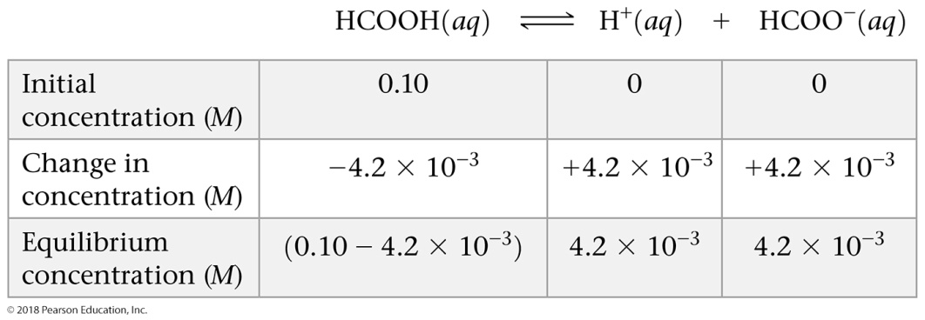
Sample Exercise 16.10 Calculating K_{a} from Measured pH
Continued
From the measured pH, we can calculate [H⁺]:
To determine the concentrations of the species involved in the equilibrium, we consider that the solution is initially 0.10 M in HCOOH molecules. We then consider the ionization of the acid into H⁺ and HCOO–. For each HCOOH molecule that ionizes, one H⁺ ion and one HCOO– ion are produced in solution. Because the pH measurement indicates that [H⁺] = 4.2 × 10^{–3} M at equilibrium, we can construct the following table:
Notice that we have neglected the very small concentration of H⁺(aq) due to H₂O autoionization. Notice also that the amount of HCOOH that ionizes is very small compared with the initial concentration of the acid. To the number of significant figures we are using, the subtraction yields 0.10 M:
(0.10 – 4.2 × 10^{–3}) M 0.10 M

Slide 21
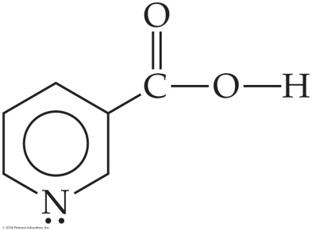
Sample Exercise 16.10 Calculating K_{a} from Measured pH
Continued
We can now insert the equilibrium concentrations into the expression for K_{a}:
Check The magnitude of our answer is reasonable because K_{a} for a weak acid is usually between 10^{–2} and 10^{–10}.
Practice Exercise 1
A 0.50 M solution of an acid HA has pH = 2.24. What is the value of K_{a} for the acid? (a) 1.7 × 10^{–12} (b) 3.3 × 10^{–5} (c) 6.6 × 10^{–5} (d) 5.8 × 10^{–3} (e) 1.2 × 10^{–2}
Practice Exercise 2
Niacin, one of the B vitamins, has the molecular structure shown at the right. A 0.020 M solution of niacin has a pH of 3.26. What is the acid-dissociation constant for niacin?

Slide 22
Sample Exercise 16.11 Calculating Percent Ionization
As calculated in Sample Exercise 16.10, a 0.10 M solution of formic acid (HCOOH) contains 4.2 × 10^{–3} M H⁺(aq). Calculate the percentage of the acid that is ionized.
Solution
Analyze We are given the molar concentration of an aqueous solution of weak acid and the equilibrium concentration of H⁺(aq) and asked to determine the percent ionization of the acid.
Plan The percent ionization is given by Equation 16.27.
Solve
Practice Exercise 1
A 0.077 M solution of an acid HA has pH = 2.16. What is the percentage of the acid that is ionized?
(a) 0.090% (b) 0.69% (c) 0.90% (d) 3.6% (e) 9.0%
Practice Exercise 2
A 0.020 M solution of niacin (see Sample Exercise 16.10) has a pH of 3.26. Calculate the percent ionization of the niacin.

Slide 23
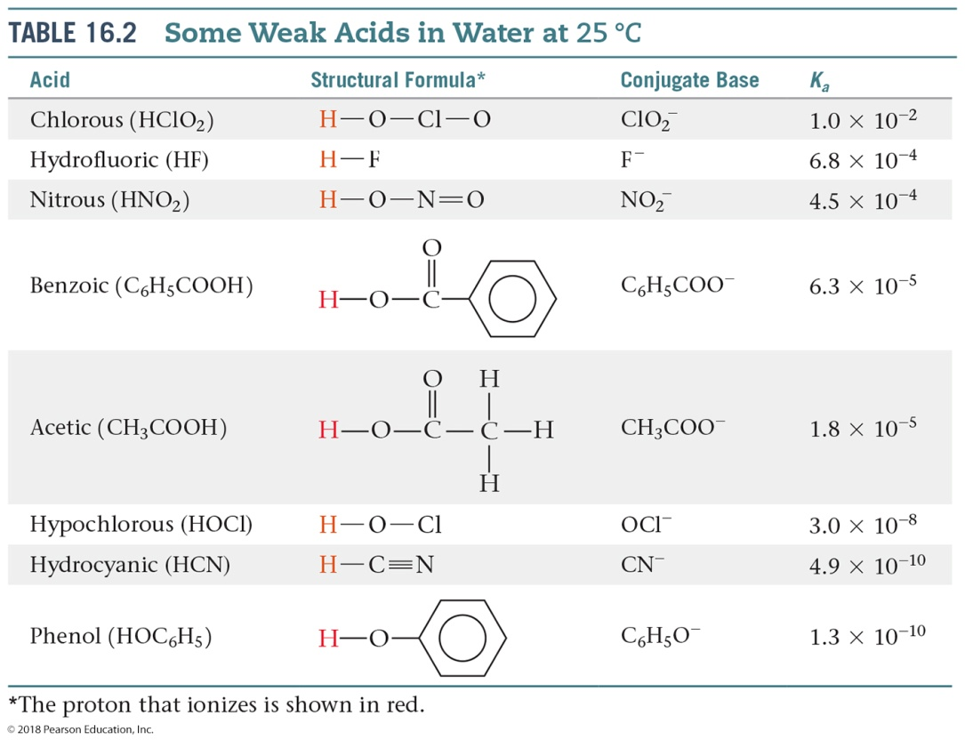
Sample Exercise 16.12 Using K_{a} to Calculate pH
Calculate the pH of a 0.20 M solution of HCN. (Refer to Table 16.2 or Appendix D for the value of K_{a}.)
Solution
Analyze We are given the molarity of a weak acid and are asked for the pH. From Table 16.2, K_{a} for HCN is 4.9 × 10^{–10}.
Plan We proceed as in the example just worked in the text, writing the chemical equation and constructing a table of initial and equilibrium concentrations in which the equilibrium concentration of H⁺ is our unknown.

Slide 24
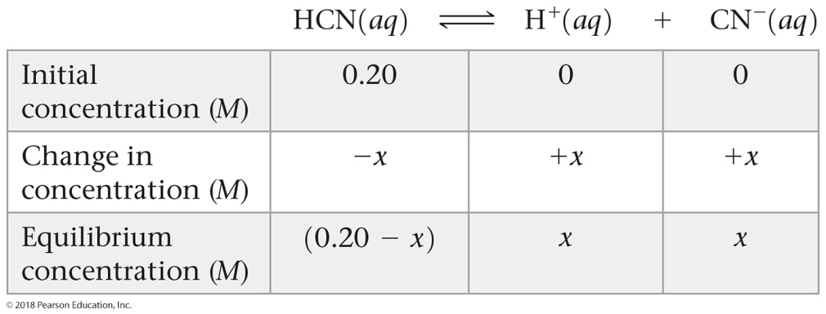
Sample Exercise 16.12 Using K_{a} to Calculate pH
Continued
Solve Writing both the chemical equation for the ionization reaction that forms H⁺(aq) and the equilibrium-constant (K_{a}) expression for the reaction:
Next, we tabulate the concentrations of the species involved in the equilibrium reaction, letting x = [H⁺] at equilibrium:
Substituting the equilibrium concentrations into the equilibrium-constant expression yields:

Slide 25
Sample Exercise 16.12 Using K_{a} to Calculate pH
Continued
We next make the simplifying approximation that x, the amount of acid that dissociates, is small compared with the initial concentration of acid, 0.20 – x 0.20. Thus,
Solving for x, we have:
A concentration of 9.9 × 10^{–6} M is much smaller than 5% of 0.20 M, the initial HCN concentration. Our simplifying approximation is therefore appropriate. We now calculate the pH of the solution:
pH = –log[H⁺] = –log(9.9 × 10^{–6}) = 5.00

Slide 26
Sample Exercise 16.12 Using K_{a} to Calculate pH
Continued
Practice Exercise 1
What is the pH of a 0.40 M solution of benzoic acid, C₆H₅COOH? (The K_{a} value for benzoic acid is given in Table 16.2.)
(a) 2.30 (b) 2.10 (c) 1.90 (d) 4.20 (e) 4.60
Practice Exercise 2
The K_{a} for niacin (Sample Exercise 16.10) is 1.5 × 10^{–5}. What is the pH of a 0.010 M solution of niacin?

Slide 27
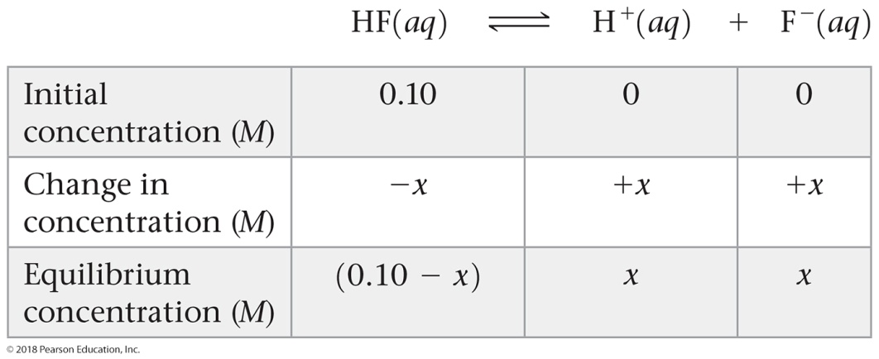
Sample Exercise 16.13 Using the Quadratic Equation to Calculate pH and Percent Ionization
Calculate the pH and percentage of HF molecules ionized in a 0.10 M HF solution.
Solution
Analyze We are asked to calculate the percent ionization of a solution of HF. From Appendix D, we find K_{a} = 6.8 × 10^{–4}.
Plan We approach this problem as for previous equilibrium problems: We write the chemical equation for the equilibrium and tabulate the known and unknown concentrations of all species. We then substitute the equilibrium concentrations into the equilibrium-constant expression and solve for the unknown concentration of H⁺.
Solve
The equilibrium reaction and equilibrium concentrations are as follows:

Slide 28
Sample Exercise 16.13 Using the Quadratic Equation to Calculate pH and Percent Ionization
Continued
The equilibrium-constant expression is:
When we try solving this equation using the approximation 0.10 – x 0.10 (that is, by neglecting the concentration of acid that ionizes), we obtain:
x = 8.2 × 10^{–3} M
Because this approximation is greater than 5% of 0.10 M, however, we should work the problem in standard quadratic form. Rearranging, we have:
Substituting these values in the standard quadratic formula gives:

Slide 29
Sample Exercise 16.13 Using the Quadratic Equation to Calculate pH and Percent Ionization
Continued
Of the two solutions, only the positive value for x is chemically reasonable. From that value, we can determine [H⁺] and hence the pH:
x = [H⁺] = [F–] = 7.9 × 10^{–3} M, so pH = –log[H⁺] = 2.10
From our result, we can calculate the percent of molecules ionized:
Practice Exercise 1
What is the pH of a 0.010 M solution of HF?
(a) 1.58 (b) 2.10 (c) 2.30 (d) 2.58 (e) 2.64
Practice Exercise 2
In Practice Exercise 2 for Sample Exercise 16.11, we found that the percent ionization of niacin (K_{a} = 1.5 × 10^{–5}) in a 0.020 M solution is 2.7%. Calculate the percentage of niacin molecules ionized in a solution that is (a) 0.010 M, (b) 1.0 × 10^{–3} M.

Slide 30
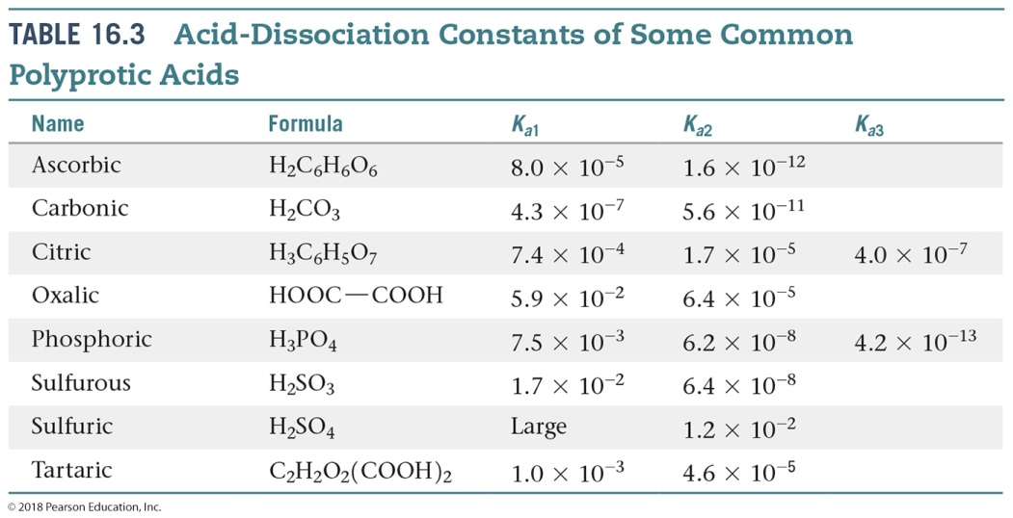
Sample Exercise 16.14 Calculating the pH of a Solution of a Polyprotic Acid
The solubility of CO₂ in water at 25 °C and 0.1 atm is 0.0037 M. The common practice is to assume that all the dissolved CO₂ is in the form of carbonic acid (H₂CO₃), which is produced in the reaction
CO₂(aq) + H₂O(l) H₂CO₃(aq)
What is the pH of a 0.0037 M solution of H₂CO₃?
Solution
Analyze We are asked to determine the pH of a 0.0037 M solution of a polyprotic acid.
Plan H₂CO₃ is a diprotic acid; the two acid-dissociation constants, K_{a1} and K_{a2} (Table 16.3), differ by more than a factor of 10³. Consequently, the pH can be determined by considering only K_{a1}, thereby treating the acid as if it were a monoprotic acid.

Slide 31
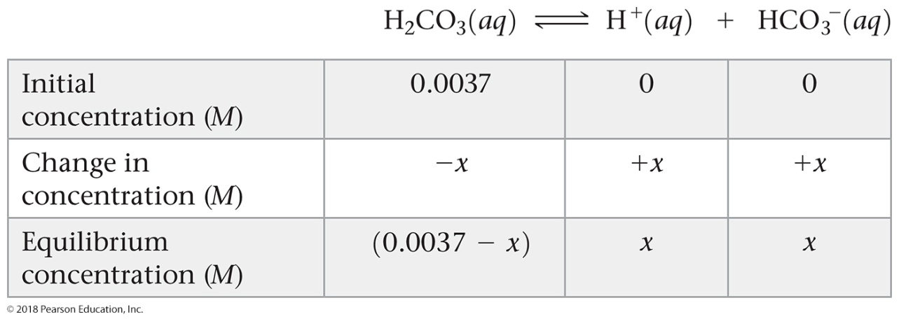
Sample Exercise 16.14 Calculating the pH of a Solution of a Polyprotic Acid
Continued
Solve
Proceeding as in Sample Exercises 16.12 and 16.13, we can write the equilibrium reaction and equilibrium concentrations as:
The equilibrium-constant expression is:
Solving this quadratic equation, we get:
x = 4.0 × 10^{–5} M

Slide 32
Sample Exercise 16.14 Calculating the pH of a Solution of a Polyprotic Acid
Continued
Alternatively, because K_{a1} is small, we can make the simplifying approximation that x is small, so that:
0.0037 – x 0.0037
Thus,
Solving for x, we have:
Because we get the same value (to two significant figures) our simplifying assumption was justified. The pH is therefore:
pH = –log[H⁺] = –log(4.0 × 10^{–5}) = 4.40

Slide 33
Sample Exercise 16.14 Calculating the pH of a Solution of a Polyprotic Acid
Continued
Comment If we were asked for [CO₃^{2–}] we would need to use K_{a2}. Let’s illustrate that calculation. Using our calculated values of [HCO₃–] and [H⁺] and setting [CO₃^{2–}] = y, we have:
Assuming that y is small relative to 4.0 × 10^{–5}, we have:

Slide 34
Sample Exercise 16.14 Calculating the pH of a Solution of a Polyprotic Acid
Continued
We see that the value for y is indeed very small compared with 4.0 × 10^{–5}, showing that our assumption was justified. It also shows that the ionization of HCO₃– is negligible relative to that of H₂CO₃, as far as production of H⁺ is concerned. However, it is the only source of CO₃^{2–}, which has a very low concentration in the solution. Our calculations thus tell us that in a solution of carbon dioxide in water, most of the CO₂ is in the form of CO₂ or H₂CO₃, only a small fraction ionizes to form H⁺ and HCO₃–, and an even smaller fraction ionizes to give CO₃^{2–}. Notice also that [CO₃^{2–}] is numerically equal to K_{a2}.
Practice Exercise 1
What is the pH of a 0.28 M solution of ascorbic acid (Vitamin C)? (See Table 16.3 for K_{a1} and K_{a2}.)
(a) 2.04 (b) 2.32 (c) 2.82 (d) 4.65 (e) 6.17
Practice Exercise 2
(a) Calculate the pH of a 0.020 M solution of oxalic acid (H₂C₂O₄). (See Table 16.3 for K_{a1} and K_{a2}.)
(b) Calculate the concentration of oxalate ion, [C₂O₄^{2–}], in this solution.

Slide 35
Sample Exercise 16.15 Using K_{b} to Calculate [OH–]
Calculate the concentration of OH– in a 0.15 M solution of NH₃.
Solution
Analyze We are given the concentration of a weak base and asked to determine the concentration of OH–.
Plan We will use essentially the same procedure here as used in solving problems involving the ionization of weak acids—that is, write the chemical equation and tabulate initial and equilibrium concentrations.
Solve
The ionization reaction and equilibrium constant expression are:
Ignoring the concentration of H₂O because it is not involved in the equilibrium-constant expression, we see that the equilibrium concentrations are:

Slide 36
Sample Exercise 16.15 Using K_{b} to Calculate [OH–]
Continued
Inserting these quantities into the equilibrium-constant expression gives:
Because K_{b} is small, the amount of NH₃ that reacts with water is much smaller than the NH₃ concentration, and so we can neglect x relative to 0.15 M. Then we have:
Check The value obtained for x is only about 1% of the NH₃ concentration, 0.15 M. Therefore, neglecting x relative to 0.15 was justified.
Comment You may be asked to find the pH of a solution of a weak base. Once you have found [OH–], you can proceed as in Sample Exercise 16.9, where we calculated the pH of a strong base. In the present sample exercise, we have seen that the 0.15 M solution of NH₃ contains [OH–] = 1.6 × 10^{–3} M. Thus, pOH = –log(1.6 × 10^{–3}) = 2.80, and pH = 14.00 – 2.80 = 11.20. The pH of the solution is above 7 because we are dealing with a solution of a base.

Slide 37
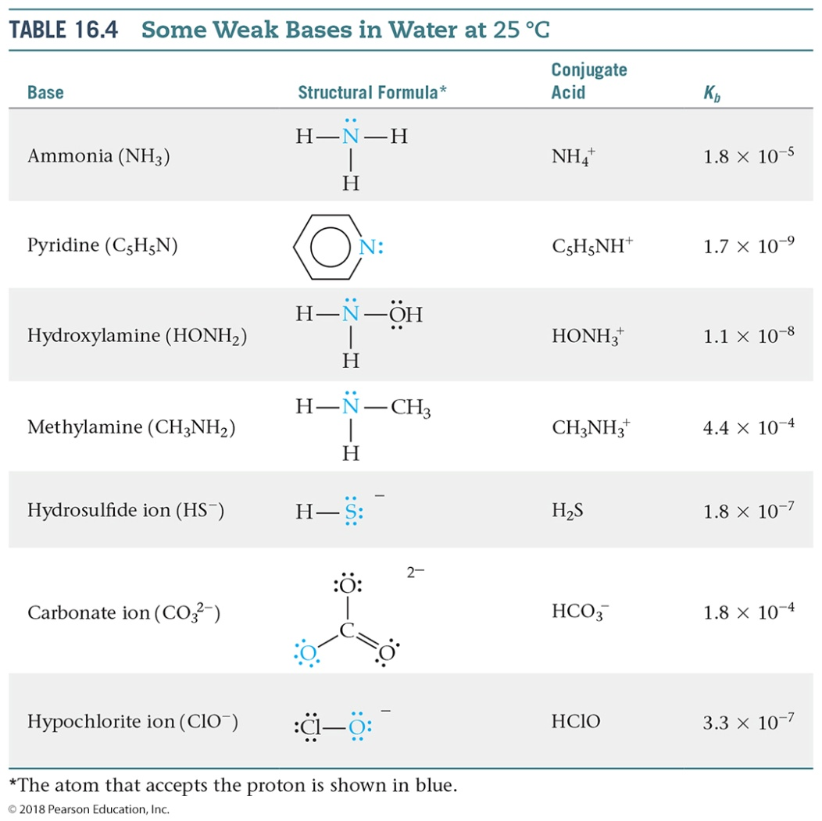
Sample Exercise 16.15 Using K_{b} to Calculate [OH–]
Continued
Practice Exercise 1
What is the pH of a 0.65 M solution of pyridine, C₅H₅N? (See Table 16.4 for K_{b}.)
(a) 4.48 (b) 8.96 (c) 9.52 (d) 9.62 (e) 9.71
Practice Exercise 2
Which of the following compounds should produce the highest pH as a 0.05 M solution: pyridine, methylamine, or nitrous acid?

Slide 38
Sample Exercise 16.16 Using pH to Determine the Concentration of a Salt
A solution made by adding solid sodium hypochlorite (NaClO) to enough water to make 2.00 L of solution has a pH of 10.50. Using the information in Equation 16.37, calculate the number of moles of NaClO added to the water.
Solution
Analyze NaClO is an ionic compound consisting of Na⁺ and ClO– ions. As such, it is a strong electrolyte that completely dissociates in solution into Na⁺, a spectator ion, and ClO– ion, a weak base with K_{b} = 3.3 × 10^{–7} (Equation 16.37). Given this information, we must calculate the number of moles of NaClO needed to increase the pH of 2.00 L of water to 10.50.
Plan From the pH, we can determine the equilibrium concentration of OH–. We can then construct a table of initial and equilibrium concentrations in which the initial concentration of ClO– is our unknown. We can calculate [ClO–] using the expression for K_{b}.
Solve
We can calculate [OH–] by using either Equation 16.16 or Equation 16.20; we will use the latter method here:
pOH = 14.00 – pH = 14.00 – 10.50 = 3.50
[OH–] = 10^{–3.50} = 3.2 × 10^{–4} M

Slide 39
Sample Exercise 16.16 Using pH to Determine the Concentration of a Salt
Continued
This concentration is high enough that we can assume that Equation 16.37 is the only source of OH–; that is, we can neglect any OH– produced by the autoionization of H₂O. We now assume a value of x for the initial concentration of ClO– and solve the equilibrium problem in the usual way.
We now use the expression for the base-dissociation constant to solve for x:

Slide 40
Sample Exercise 16.16 Using pH to Determine the Concentration of a Salt
Continued
We say that the solution is 0.31 M in NaClO even though some of the ClO– ions have reacted with water. Because the solution is 0.31 M in NaClO and the total volume of solution is 2.00 L, 0.62 mol of NaClO is the amount of the salt that was added to the water.
Practice Exercise 1
The benzoate ion, C₆H₅COO– , is a weak base with K_{b} = 1.6 × 10^{–10}. How many moles of sodium benzoate are present in 0.50 L of a solution of NaC₆H₅COO if the pH is 9.04?
(a) 0.38 (b) 0.66 (c) 0.76 (d) 1.5 (e) 2.9
Practice Exercise 2
What is the molarity of an aqueous NH₃ solution that has a pH of 11.17?

Slide 41
Sample Exercise 16.17 Calculating K_{a} or K_{b} for a Conjugate Acid–Base Pair
Calculate (a) K_{b} for the fluoride ion, (b) K_{a} for the ammonium ion.
Solution
Analyze We are asked to determine dissociation constants for F–, the conjugate base of HF, and NH₄⁺, the conjugate acid of NH₃.
Plan We can use the tabulated K values for HF and NH₃ and the relationship between K_{a} and K_{b} to calculate the dissociation constants for their conjugates, F– and NH₄⁺.
Solve
(a) For the weak acid HF, Table 16.2 and Appendix D give K_{a} = 6.8 × 10^{–4}. We can use Equation 16.40 to calculate K_{b} for the conjugate base, F–:

Slide 42
Sample Exercise 16.17 Calculating K_{a} or K_{b} for a Conjugate Acid–Base Pair
Continued
(b) For NH₃, Table 16.4 and Appendix D give K_{b} = 1.8 × 10^{–5}, and this value in Equation 16.40 gives us K_{a} for the conjugate acid, NH₄⁺:

Slide 43
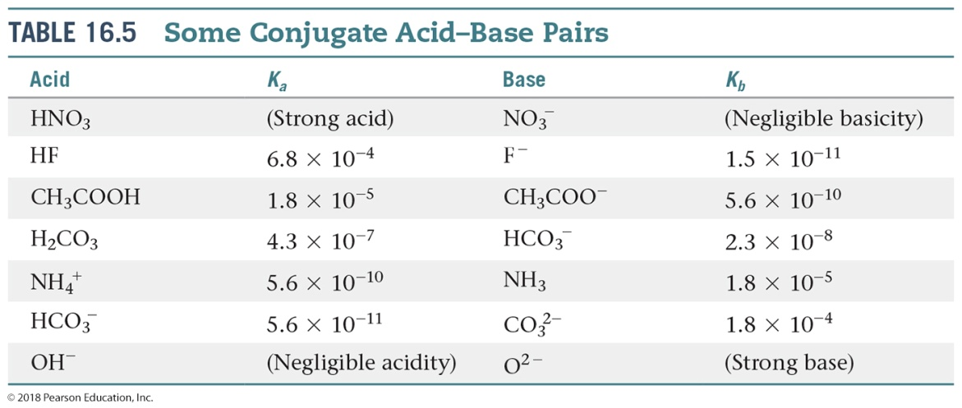
Sample Exercise 16.17 Calculating K_{a} or K_{b} for a Conjugate Acid–Base Pair
Continued
Check The respective K values for F– and NH₄⁺ are listed in Table 16.5, where we see that the values calculated here agree with those in Table 16.5.
Practice Exercise 1
By using information from Appendix D, put the following three substances in order of weakest to strongest base:
(i) (CH₃)₃N, (ii) HCOO–, (iii) BrO–.
(a) i < ii < iii (b) ii < i < iii (c) iii < i < ii (d) ii < iii < i (e) iii < ii < i

Slide 44
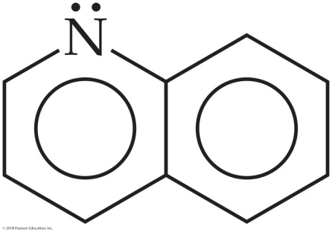
Sample Exercise 16.17 Calculating K_{a} or K_{b} for a Conjugate Acid–Base Pair
Continued
Practice Exercise 2
(a) Based on information in Appendix D, which of these anions has the largest base-dissociation constant: NO₂–, PO₄^{3–}, or N₃–?
(b) The base quinoline has the structure
Its conjugate acid is listed in handbooks as having a pK_{a} of 4.90. What is the base-dissociation constant for quinoline?

Slide 45
Sample Exercise 16.18 Determining Whether Salt Solutions Are Acidic, Basic, or Neutral
Determine whether aqueous solutions of each of these salts are acidic, basic, or neutral: (a) Ba(CH₃COO)₂, (b) NH₄Cl, (c) CH₃NH₃Br, (d) KNO₃, (e) Al(ClO₄)₃.
Solution
Analyze We are given the chemical formulas of five ionic compounds (salts) and asked whether their aqueous solutions will be acidic, basic, or neutral.
Plan We can determine whether a solution of a salt is acidic, basic, or neutral by identifying the ions in solution and by assessing how each ion will affect the pH.
Solve
(a) This solution contains barium ions and acetate ions. The cation is an ion of a heavy alkaline earth metal and will therefore not affect the pH. The anion, CH₃COO– , is the conjugate base of the weak acid CH₃COOH and will hydrolyze to produce OH– ions, thereby making the solution basic.
(b) In this solution, NH₄⁺ is the conjugate acid of a weak base (NH₃) and is therefore acidic. Cl– is the conjugate base of a strong acid (HCl) and therefore has no influence on the pH of the solution. Because the solution contains an ion that is acidic (NH₄⁺) and one that has no influence on pH (Cl–), the solution of NH₄Cl will be acidic.
(c) Here CH₃NH₃⁺ is the conjugate acid of a weak base (CH₃NH₂, an amine) and is therefore acidic, and Br– is the conjugate base of a strong acid (HBr) and therefore pH neutral. Because the solution contains one ion that is acidic and one that has no influence on pH, the solution of CH₃NH₃Br will be acidic.

Slide 46
Sample Exercise 16.18 Determining Whether Salt Solutions Are Acidic, Basic, or Neutral
Continued
(d) This solution contains the K⁺ ion, which is a cation of group 1A, and the NO₃– ion, which is the conjugate base of the strong acid HNO₃. Neither of the ions will react with water to any appreciable extent, making the solution neutral.
(e) This solution contains Al³⁺ and ClO₄– ions. Cations, such as Al³⁺, that have a charge of 3+ or higher are acidic. The ClO₄– ion is the conjugate base of a strong acid (HClO₄) and therefore does not affect pH. Thus, the solution of Al(ClO₄)₃ will be acidic.
Practice Exercise 1
Order the following solutions from lowest to highest pH:
(i) 0.10 M NaClO, (ii) 0.10 M KBr, (iii) 0.10 M NH₄ClO₄.
(a) i < ii < iii (b) ii < i < iii (c) iii < i < ii
(d) ii < iii < i (e) iii < ii < i
Practice Exercise 2
Indicate which salt in each of the following pairs forms the more acidic (or less basic) 0.010 M solution:
(a) NaNO₃ or Fe(NO₃)₃, (b) KBr or KBrO,
(c) CH₃NH₃Cl or BaCl₂, (d) NH₄NO₂ or NH₄NO₃.

Slide 47
Sample Exercise 16.19 Predicting Whether the Solution of an Amphiprotic Anion Is Acidic or Basic
Predict whether the salt Na₂HPO₄ forms an acidic solution or a basic solution when dissolved in water.
Solution
Analyze We are asked to predict whether a solution of Na₂HPO₄ is acidic or basic. This substance is an ionic compound composed of Na⁺ and HPO₄^{2–} ions.
Plan We need to evaluate each ion, predicting whether it is acidic or basic. Because Na⁺ is a cation of group 1A, it has no influence on pH. Thus, our analysis of whether the solution is acidic or basic must focus on the behavior of the HPO₄^{2–} ion. We need to consider that HPO₄^{2–} can act as either an acid or a base:
As acid HPO₄^{2–} (aq) H+(aq) + PO₄^{3–} (aq) [16.46]
As base HPO₄^{2–} (aq) + H₂O H₂PO₄–(aq) + OH–(aq) [16.47]
Of these two reactions, the one with the larger equilibrium constant determines whether the solution is acidic or basic.

Slide 48
Sample Exercise 16.19 Predicting Whether the Solution of an Amphiprotic Anion Is Acidic or Basic
Continued
Solve The value of K_{a} for Equation 16.46 is K_{a3} for H₃PO₄: 4.2 × 10^{–13} (Table 16.3). For Equation 16.47, we must calculate K_{b} for the base HPO₄^{2–} from the value of K_{a} for its conjugate acid, H₂PO₄–, and the relationship K_{a} × K_{b} = K_{w} (Equation 16.40). The relevant value of K_{a} for H₂PO₄– is K_{a2} for H₃PO₃: 6.2 × 10^{–8} (from Table 16.3). We therefore have
This K_{b} value is more than 10⁵ times larger than K_{a} for HPO₄^{2–}; thus, the reaction in Equation 16.47 predominates over that in Equation 16.46, and the solution is basic.

Slide 49
Sample Exercise 16.19 Predicting Whether the Solution of an Amphiprotic Anion Is Acidic or Basic
Continued
Practice Exercise 1
How many of the following salts are expected to produce acidic solutions (see Table 16.3 for data):
NaHSO₄, NaHC₂O₄, NaH₂PO₄, and NaHCO₃?
(a) 0 (b) 1 (c) 2 (d) 3 (e) 4
Practice Exercise 2
Predict whether the dipotassium salt of citric acid (K₂HC₆H₅O₇) forms an acidic or basic solution in water (see
Table 16.3 for data).

Slide 50
Sample Exercise 16.20 Predicting Relative Acidities from Composition and Structure
Arrange the compounds in each series in order of increasing acid strength: (a) AsH₃, HBr, KH, H₂Se; (b) H₂SO₄, H₂SeO₃, H₂SeO₄.
Solution
Analyze We are asked to arrange two sets of compounds in order from weakest acid to strongest acid. In (a), the substances are binary compounds containing H, and in (b) the substances are oxyacids.
Plan For the binary compounds, we will consider the electronegativities of As, Br, K, and Se relative to the electronegativity of H. The higher the electronegativity of these atoms, the higher the partial positive charge on H and so the more acidic the compound.
For the oxyacids, we will consider both the electronegativities of the central atom and the number of oxygen atoms bonded to the central atom.
Solve
(a) Because K is on the left side of the periodic table, it has a very low electronegativity (0.8, from Figure 8.8, p. 310). As a result, the hydrogen in KH carries a negative charge. Thus, KH should be the least acidic (most basic) compound in the series.
Arsenic and hydrogen have similar electronegativities, 2.0 and 2.1, respectively. This means that the As—H bond is nonpolar, and so AsH₃ has little tendency to donate a proton in aqueous solution.

Slide 51
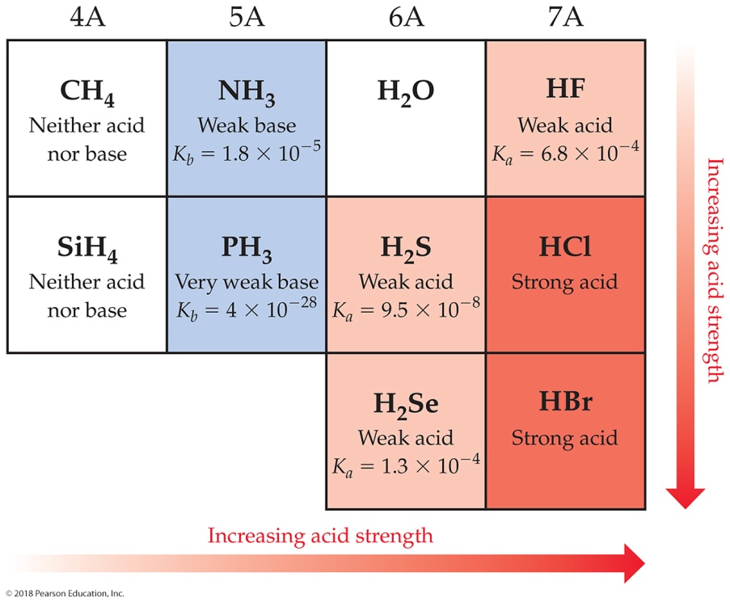
Sample Exercise 16.20 Predicting Relative Acidities from Composition and Structure
Continued
The electronegativity of Se is 2.4, and that of Br is 2.8. Consequently, the H Br bond is more polar than the H Se bond, giving HBr the greater tendency to donate a proton. (This expectation is confirmed by Figure 16.19, where we see that H₂Se is a weak acid and HBr a strong acid.) Thus, the order of increasing acidity is KH < AsH₃ < H₂Se < HBr.
(b) The acids H₂SO₄ and H₂SeO₄ have the same number of O atoms and the same number of OH groups. In such cases, the acid strength increases with increasing electronegativity of the central atom. Because S is slightly more electronegative than Se (2.5 vs 2.4), we predict that H₂SO₄ is more acidic than H₂SeO₄.
For acids with the same central atom, the acidity increases as the number of oxygen atoms bonded to the central atom increases. Thus, H₂SeO₄ should be a stronger acid than H₂SeO₃. We predict the order of increasing acidity to be H₂SeO₃ < H₂SeO₄ < H₂SO₄.

Slide 52
Sample Exercise 16.20 Predicting Relative Acidities from Composition and Structure
Continued
Practice Exercise 1
Arrange the following substances in order from weakest to strongest acid: HClO₃, HOI, HBrO₂, HClO₂, HIO₂.
(a) HIO₂ < HOI < HClO₃ < HBrO₂ < HClO₂
(b) HOI < HIO₂ < HBrO₂ < HClO₂ < HClO₃
(c) HBrO₂ < HIO₂ < HClO₂ < HOI < HClO₃
(d) HClO₃ < HClO₂ < HBrO₂ < HIO₂ < HOI
(e) HOI < HClO₂ < HBrO₂ < HIO₂ < HClO₃
Practice Exercise 2
In each pair, choose the compound that gives the more acidic (or less basic) solution: (a) HBr, HF; (b) PH₃, H₂S;
(c) HNO₂, HNO₃; (d) H₂SO₃, H₂SeO₃.

Slide 53
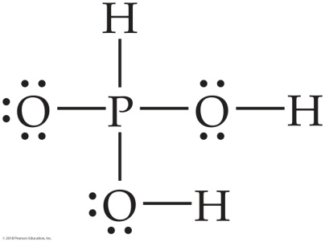
Sample Integrative Exercise Putting Concepts Together
Phosphorous acid (H₃PO₃) has the Lewis structure shown at right.
(a) Explain why H₃PO₃ is diprotic and not triprotic. (b) A 25.0-mL sample of an H₃PO₃ solution titrated with 0.102 M NaOH requires 23.3 mL of NaOH to neutralize both acidic protons. What is the molarity of the H₃PO₃ solution? (c) The original solution from part (b) has a pH of 1.59. Calculate the percent ionization and K_{a1} for H₃PO₃, assuming that K_{a1} K_{a2}. (d) How does the osmotic pressure of a 0.050 M solution of HCl compare qualitatively with that of a 0.050 M solution of H₃PO₃? Explain.
Solution
We will use what we have learned about molecular structure and its impact on acidic behavior to answer part (a). We will then use stoichiometry and the relationship between pH and [H⁺] to answer parts (b) and (c). Finally, we will consider percent ionization in order to compare the osmotic pressure of the two solutions in part (d).
(a) Acids have polar H X bonds. From Figure 8.8 (p. 310) we see that the electronegativity of H is 2.1 and that of P is also 2.1. Because the two elements have the same electronegativity, the H P bond is nonpolar. (Section 8.4) Thus, this H cannot be acidic. The other two H atoms, however, are bonded to O, which has an electronegativity of 3.5. The H O bonds are, therefore, polar with H having a partial positive charge. These two H atoms are consequently acidic.

Slide 54
Sample Integrative Exercise Putting Concepts Together
Continued
(b) The chemical equation for the neutralization reaction is:
H₃PO₃(aq) + 2 NaOH(aq) Na₂HPO₃(aq) + 2 H₂O(l)
From the definition of molarity, M = mol/L, we see that moles = M × L. (Section 4.5) Thus, the number of moles of NaOH added to the solution is:
The balanced equation indicates that 2 mol of NaOH is consumed for each mole of H₃PO₃. Thus, the number of moles of H₃PO₃ in the sample is:
The concentration of the H₃PO₃ solution, therefore, equals (1.19 × 10^{–3} mol)/(0.0250 L) = 0.0476 M.

Slide 55
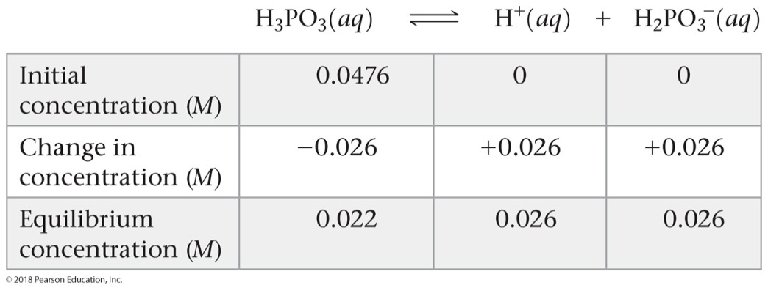
Sample Integrative Exercise Putting Concepts Together
Continued
(c) From the pH of the solution, 1.59, we can calculate [H⁺] at equilibrium:
[H⁺] = antilog(–1.59) = 10^{–1.59} = 0.026 M (two significant figures)
Because K_{a1} K_{a2}, the vast majority of the ions in solution are from the first ionization step of the acid.
Because one H₂PO₃– ion forms for each H⁺ ion formed, the equilibrium concentrations of H⁺ and H₂PO₃– are equal: [H⁺] = [H₂PO₃–] = 0.026 M. The equilibrium concentration of H₃PO₃ equals the initial concentration minus the amount that ionizes to form H⁺ and H₂PO₃–: [H₃PO₃] = 0.0476 M – 0.026 M = 0.022 M (two significant figures). These results can be tabulated as follows:
The percent ionization is:

Slide 56
Sample Integrative Exercise Putting Concepts Together
Continued
The first acid-dissociation constant is:
(d) Osmotic pressure is a colligative property and depends on the total concentration of particles in solution. (Section 13.5) Because HCl is a strong acid, a 0.050 M solution will contain 0.050 M H⁺(aq) and 0.050 M Cl–(aq), or a total of 0.100 mol/L of particles. Because H₃PO₃ is a weak acid, it ionizes to a lesser extent than HCl and, hence, there are fewer particles in the H₃PO₃ solution. As a result, the H₃PO₃ solution will have the lower osmotic pressure.

