Slide 1
Sample Exercise 20.1 Identifying Oxidizing and Reducing Agents
The nickel–cadmium (nicad) battery uses the following redox reaction to generate electricity:
Cd(s) + NiO₂(s) + 2 H₂O(l) Cd(OH)₂(s) + Ni(OH)₂(s)
Identify the substances that are oxidized and reduced, and indicate which is the oxidizing agent and which is the reducing agent.
Solution
Analyze We are given a redox equation and asked to identify the substance oxidized and the substance reduced and to label the oxidizing agent and the reducing agent.
Plan First, we use the rules outlined earlier (Section 4.4) to assign oxidation states, or numbers, to all the atoms and determine which elements change oxidation state. Second, we apply the definitions of oxidation and reduction.
Solve
The oxidation state of Cd increases from 0 to +2, and that of Ni decreases from +4 to +2. Thus, the Cd atom is oxidized (loses electrons) and is the reducing agent. The oxidation state of Ni decreases as NiO₂ is converted into Ni(OH)₂. Thus, NiO₂ is reduced (gains electrons) and is the oxidizing agent.

Slide 2
Sample Exercise 20.1 Identifying Oxidizing and Reducing Agents
Continued
Comment A common mnemonic for remembering oxidation and reduction is “LEO the lion says GER”: losing electrons is oxidation; gaining electrons is reduction.
Practice Exercise 1
What is the reducing agent in the following reaction?
2 Br–(aq) + H₂O₂(aq) + 2 H⁺(aq) Br₂(aq) + 2 H₂O(l)
(a) Br–(aq) (b) H₂O₂(aq) (c) H⁺(aq) (d) Br₂(aq)
Practice Exercise 2
Identify the oxidizing and reducing agents in the reaction
2 H₂O(l) + Al(s) + MnO₄–(aq) Al(OH)₄–(aq) + MnO₂(s)

Slide 3
Sample Exercise 20.2 Balancing Redox Equations in Acidic Solution
Complete and balance this equation by the method of half-reactions:
Cr₂O₇^{2–}(aq) + Cl–(aq) Cr³⁺(aq) + Cl₂(g) (acidic solution)
Solution
Analyze We are given an incomplete, unbalanced (skeleton) equation for a redox reaction occurring in acidic solution and asked to complete and balance it.
Plan We use the half-reaction procedure we just learned.
Solve
Step 1: We divide the equation into two half-reactions:
Cr₂O₇^{2–}(aq) Cr³⁺(aq)
Cl–(aq) Cl₂(g)
Step 2: We balance each half-reaction. In the first half-reaction the presence of one Cr₂O₇^{2–} among the reactants requires two Cr³⁺ among the products. The seven oxygen atoms in Cr₂O₇^{2–} are balanced by adding seven H₂O to the products. The 14 hydrogen atoms in 7 H₂O are then balanced by adding 14 H⁺ to the reactants:
14 H⁺(aq) + Cr₂O₇^{2–}(aq) 2 Cr³⁺(aq) + 7 H₂O(l)

Slide 4
Sample Exercise 20.2 Balancing Redox Equations in Acidic Solution
Continued
We then balance the charge by adding electrons to the left side of the equation so that the total charge is the same on the two sides:
6 e– + 14 H⁺(aq) + Cr₂O₇^{2–}(aq) 2 Cr³⁺(aq) + 7 H₂O(l)
We can check this result by looking at the oxidation state changes. Each chromium atom goes from +6 to +3, gaining three electrons; therefore, the two Cr atoms in Cr₂O₇^{2–} gain six electrons, in agreement with our half-reaction.
In the second half-reaction, two Cl– are required to balance one Cl₂:
2 Cl–(aq) Cl₂(g)
We add two electrons to the right side to attain charge balance:
2 Cl–(aq) Cl₂(g) + 2 e–
This result agrees with the oxidation state changes. Each chlorine atom goes from –1 to 0, losing one electron; therefore, the two chlorine atoms lose two electrons.

Slide 5
Sample Exercise 20.2 Balancing Redox Equations in Acidic Solution
Continued
Step 3: We equalize the number of electrons transferred in the two half-reactions. To do so, we multiply the Cl half-reaction by 3 so that the number of electrons gained in the Cr half-reaction (6) equals the number lost in the Cl half-reaction, allowing the electrons to cancel when the half-reactions are added:
6 Cl–(aq) 3 Cl₂(g) + 6 e–
Step 4: The equations are added to give the balanced equation:
14 H⁺(aq) + Cr₂O₇^{2–}(aq) + 6 Cl–(aq) 2 Cr³⁺(aq) + 7 H₂O(l) + 3 Cl₂(g)
Step 5: There are equal numbers of atoms of each kind on the two sides of the equation (14 H, 2 Cr, 7 O, 6 Cl). In addition, the charge is the same on the two sides (6+). Thus, the equation is balanced.
Practice Exercise 1
If you complete and balance the following equation in acidic solution
Mn²⁺(aq) + NaBiO₃(s) Bi³⁺(aq) + MnO₄–(aq) + Na+(aq)
how many water molecules are there in the balanced equation (for the reaction balanced with the smallest whole-number coefficients)? (a) Four on the reactant side (b) Three on the product side (c) One on the reactant side (d) Seven on the product side (e) Two on the product side

Slide 6
Sample Exercise 20.2 Balancing Redox Equations in Acidic Solution
Continued
Practice Exercise 2
Complete and balance the following equation in acidic solution using the method of half-reactions.
Cu(s) + NO₃–(aq) Cu²⁺(aq) + NO₂(g)

Slide 7
Sample Exercise 20.3 Balancing Redox Equations in Basic Solution
Complete and balance this equation for a redox reaction that takes place in basic solution:
CN–(aq) + MnO₄–(aq) CNO–(aq) + MnO₂(s) (basic solution)
Solution
Analyze We are given an incomplete equation for a basic redox reaction and asked to balance it.
Plan We go through the first steps of our procedure as if the reaction were occurring in acidic solution. We then add the appropriate number of OH– to each side of the equation, combining H+ and OH– to form H₂O. We complete the process by simplifying the equation.
Solve
Step 1: We write the incomplete, unbalanced half-reactions:
CN–(aq) CNO–(aq)
MnO₄–(aq) MnO₂(s)
Step 2: We balance each half-reaction as if it took place in acidic solution:
CN–(aq) + H₂O(l) CNO–(aq) + 2 H⁺(aq) + 2 e–
3 e– + 4 H⁺(aq) + MnO₄–(aq) MnO₂(s) + 2 H₂O(l)

Slide 8
Sample Exercise 20.3 Balancing Redox Equations in Basic Solution
Continued
Now we must take into account that the reaction occurs in basic solution, adding OH– to both sides of both half-reactions to neutralize H⁺:
CN–(aq) + H₂O(l) + 2 OH–(aq) CNO–(aq) + 2 H⁺(aq) + 2 e– + 2 OH–(aq)
3 e– + 4 H⁺(aq) + MnO₄–(aq) + 4 OH–(aq) MnO₂(s) + 2 H₂O(l) + 4 OH–(aq)
We “neutralize” H⁺ and OH– by forming H₂O when they are on the same side of either half-reaction:
CN–(aq) + H₂O(l) + 2 OH–(aq) CNO–(aq) + 2 H₂O(l) + 2 e–
3 e– + 4 H₂O(l) + MnO₄–(aq) MnO₂(s) + 2 H₂O(l) + 4 OH–(aq)
Next, we cancel water molecules that appear as both reactants and products:
CN–(aq) + 2 OH–(aq) CNO–(aq) + H₂O(l) + 2 e–
3 e– + 2 H₂O(l) + MnO₄–(aq) MnO₂(s) + 4 OH–(aq)
Both half-reactions are now balanced. You can check the atoms and the overall charge.

Slide 9
Sample Exercise 20.3 Balancing Redox Equations in Basic Solution
Continued
Step 3: We multiply the cyanide half-reaction by 3, which gives six electrons on the product side, and multiply the permanganate half-reaction by 2, which gives six electrons on the reactant side:
3 CN–(aq) + 6 OH–(aq) 3 CNO–(aq) + 3 H₂O(l) + 6 e–
6 e– + 4 H₂O(l) + 2 MnO₄–(aq) 2 MnO₂(s) + 8 OH–(aq)
Step 4: We add the two half-reactions together and simplify by canceling species that appear as both reactants and products:
3 CN–(aq) + H₂O(l) + 2 MnO₄–(aq) 3 CNO–(aq) + 2 MnO₂(s) + 2 OH–(aq)
Step 5: Check that the atoms and charges are balanced.
There are 3 C, 3 N, 2 H, 9 O, 2 Mn, and a charge of 5− on both sides of the equation.
Comment It is important to remember that this procedure does not imply that H⁺ ions are involved in the chemical reaction. Recall that in aqueous solutions at 25 °C, K_{w} = [H⁺][OH–] = 1.0 × 10^{–14}. Thus, [H⁺] is very small in this basic solution. (Section 16.3)

Slide 10
Sample Exercise 20.3 Balancing Redox Equations in Basic Solution
Continued
Practice Exercise 1
If you complete and balance the following oxidation–reduction reaction in basic solution
NO₂–(aq) + Al(s) NH₃(aq) + Al(OH)₄–(aq)
how many hydroxide ions are there in the balanced equation (for the reaction balanced with the smallest whole-number
coefficients)?
(a) One on the reactant side (b) One on the product side
(c) Four on the reactant side (d) Seven on the product side
(e) None
Practice Exercise 2
Complete and balance the following oxidation–reduction reaction in basic solution:
Cr(OH)₃(s) + ClO–(aq) CrO₄^{2–}(aq) + Cl₂(g)

Slide 11
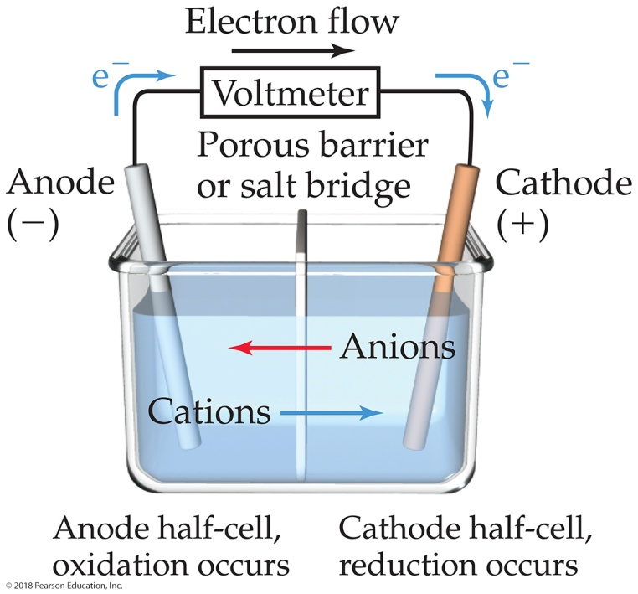
Sample Exercise 20.4 Describing a Voltaic Cell
The oxidation–reduction reaction
Cr₂O₇^{2–}(aq) + 14 H⁺(aq) + 6 I–(aq) 2 Cr³⁺(aq) + 3 I₂(s) + 7 H₂O(l)
is spontaneous. A solution containing K₂Cr₂O₇ and H₂SO₄ is poured into one beaker, and a solution of KI is poured into another. A salt bridge is used to join the beakers. A metallic conductor that will not react with either solution (such as platinum foil) is suspended in each solution, and the two conductors are connected with wires through a voltmeter or some other device to detect an electric current. The resulting voltaic cell generates an electric current. Indicate the reaction occurring at the anode, the reaction at the cathode, the direction of electron migration, the direction of ion migration, and the signs of the electrodes.
Solution
Analyze We are given the equation for a spontaneous reaction that takes place in a voltaic cell and a description of how the cell is constructed. We are asked to write the half-reactions occurring at the anode and at the cathode, as well as the directions of electron and ion movements and the signs assigned to the electrodes.
Plan Our first step is to divide the chemical equation into half-reactions so that we can identify the oxidation and the reduction processes. We then use the definitions of anode and cathode and the other terminologies summarized in Figure 20.6.

Slide 12
Sample Exercise 20.4 Describing a Voltaic Cell
Continued
Solve In one half-reaction, Cr₂O₇^{2–}(aq) is converted into Cr³⁺(aq). Starting with these ions and then completing and balancing the half-reaction, we have
Cr₂O₇^{2–}(aq) + 14 H⁺(aq) + 6 e– 2 Cr³⁺(aq) + 7 H₂O(l)
In the other half-reaction, I–(aq) is converted to I₂(s):
6 I–(aq) 3 I₂(s)+6 e–
Now we can use the summary in Figure 20.6 to help us describe the voltaic cell. The first half-reaction is the reduction process (electrons on the reactant side of the equation). By definition, the reduction process occurs at the cathode. The second half-reaction is the oxidation process (electrons on the product side of the equation), which occurs at the anode.
The I– ions are the source of electrons, and the Cr₂O₇^{2–} ions accept the electrons. Hence, the electrons flow through the external circuit from the electrode immersed in the KI solution (the anode) to the electrode immersed in the K₂Cr₂O₇–H₂SO₄ solution (the cathode). The electrodes themselves do not react in any way; they merely provide a means of transferring electrons from or to the solutions. The cations move through the solutions toward the cathode, and the anions move toward the anode. The anode (from which the electrons move) is the negative electrode, and the cathode (toward which the electrons move) is the positive electrode.

Slide 13
Sample Exercise 20.4 Describing a Voltaic Cell
Continued
Practice Exercise 1
The following two half-reactions occur in a voltaic cell:
Ni(s) Ni²⁺(aq) + 2 e– (electrode = Ni)
Cu²⁺(aq) + 2 e– Cu(s) (electrode = Cu)
Which one of the following descriptions most accurately describes what is occurring in the half-cell containing the Cu electrode and Cu²⁺(aq) solution?
(a) The electrode is losing mass and cations from the salt bridge are flowing into the half-cell.
(b) The electrode is gaining mass and cations from the salt bridge are flowing into the half-cell.
(c) The electrode is losing mass and anions from the salt bridge are flowing into the half-cell.
(d) The electrode is gaining mass and anions from the salt bridge are flowing into the half-cell.
Practice Exercise 2
The two half-reactions in a voltaic cell are
Zn(s) Zn²⁺(aq) + 2 e– (electrode = Zn)
ClO₃–(aq) + 6 H⁺(aq) + 6 e– Cl–(aq) + 3 H₂O(l) (electrode = Pt)
(a) Indicate which reaction occurs at the anode and which at the cathode. (b) Does the zinc electrode gain, lose, or retain the same mass as the reaction proceeds? (c) Does the platinum electrode gain, lose, or retain the same mass as the reaction proceeds? (d) Which electrode is positive?

Slide 14
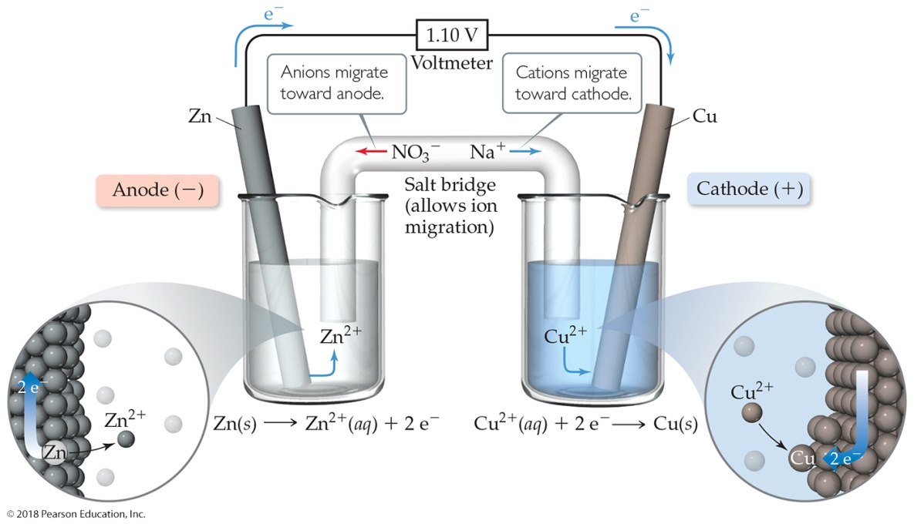
Sample Exercise 20.5 Calculating E°_{red} from E°_{cell}
For the Zn–Cu voltaic cell shown in Figure 20.5, we have
Zn(s) + Cu²⁺(aq, 1 M) Zn²⁺(aq, 1 M) + Cu(s) E°_{cell} = 1.10 V
Given that the standard reduction potential of Zn²⁺ to Zn(s) is –0.76 V, calculate the E°_{red} for the reduction of Cu²⁺ to Cu:
Cu²⁺(aq, 1 M) + 2 e– Cu(s)
Solution
Analyze We are given E°_{cell} and E°_{red} for Zn²⁺ and asked to calculate E°_{red} for Cu²⁺.

Slide 15
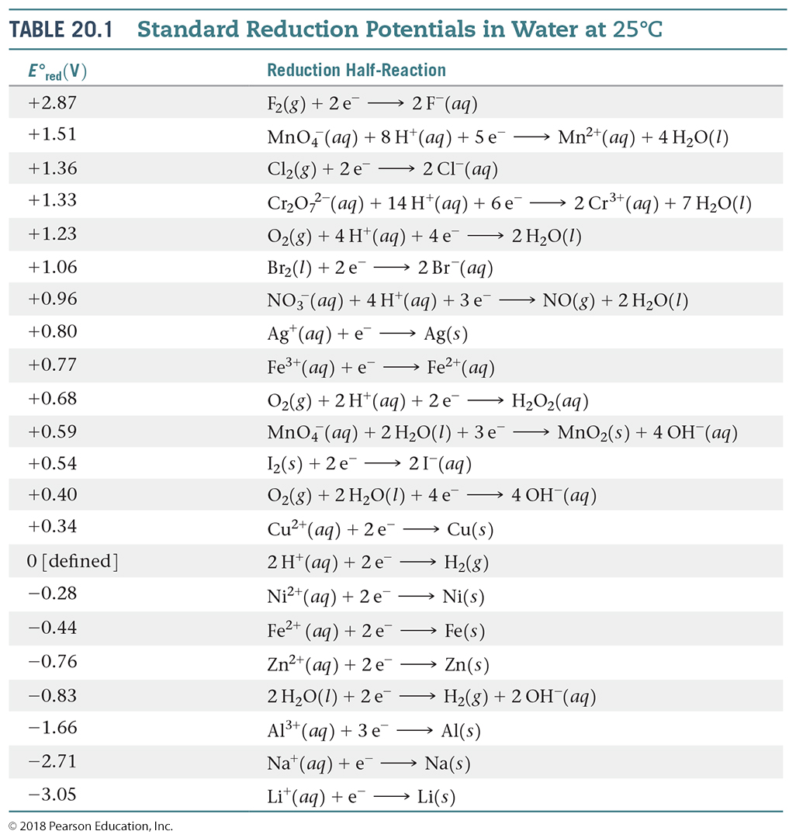
Sample Exercise 20.5 Calculating E°_{red} from E°_{cell}
Continued
Plan In the voltaic cell, Zn is oxidized and is therefore the anode. Thus, the given E°_{red} for Zn²⁺ is E°_{red} (anode). Because Cu²⁺ is reduced, it is in the cathode half-cell. Thus, the unknown reduction potential for Cu²⁺ is E°_{red} (cathode). Knowing E°_{cell} and E°_{red} (anode), we can use Equation 20.8 to solve for E°_{red} (cathode).
Solve
E°_{cell} = E°_{red} (cathode) – E°_{red} (anode)
1.10 V = E°_{red} (cathode) – (–0.76 V)
E°_{red} (cathode) = 1.10 V – 0.76 V = 0.34 V
Check This standard reduction potential agrees with the one listed in Table 20.1.
Comment The standard reduction potential for Cu²⁺ can be represented as E°_{Cu}²⁺ = 0.34 V and that for Zn²⁺ as E°_{Zn}²⁺ = –0.76 V. The subscript identifies the ion that is reduced in the reduction half-reaction.

Slide 16
Sample Exercise 20.5 Calculating E°_{red} from E°_{cell}
Continued
Practice Exercise 1
A voltaic cell based on the reaction 2 Eu²⁺(aq) + Ni²⁺(aq) 2 Eu³⁺(aq) + Ni(s) generates E°_{cell} = 0.07 V. Given the standard reduction potential of Ni²⁺ given in Table 20.1, what is the standard reduction potential for the reaction Eu³⁺(aq) + e– Eu²⁺(aq)?
(a) –0.35 V (b) 0.35 V (c) –0.21 V (d) 0.21 V (e) 0.07 V
Practice Exercise 2
The standard cell potential is 1.46 V for a voltaic cell based on the following half-reactions:
In⁺(aq) In³⁺(aq) + 2 e–
Br₂(l) + 2 e– 2 Br–(aq)
Using Table 20.1, calculate E°_{red} for the reduction of In³⁺ to In⁺.

Slide 17
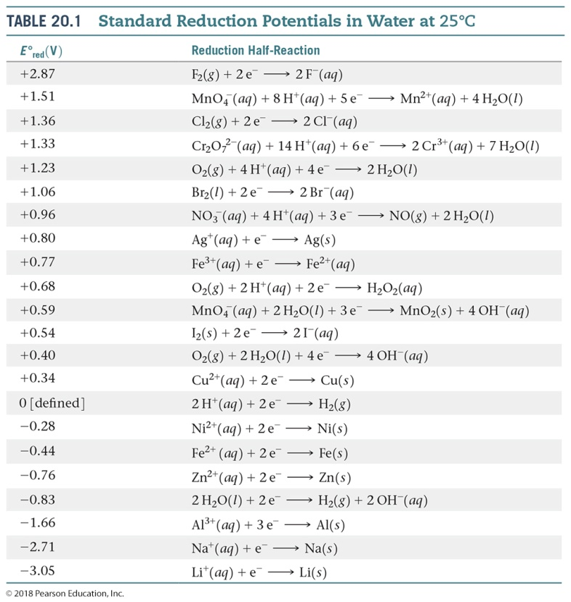
Sample Exercise 20.6 Calculating E°_{cell} from E°_{red}
Use Table 20.1 to calculate E°_{cell} for the voltaic cell described in Sample Exercise 20.4, which is based on the reaction
Cr₂O₇^{2–}(aq) + 14 H⁺(aq) + 6 I–(aq)
2 Cr³⁺(aq) + 3 I₂(s) + 7 H₂O(l)
Solution
Analyze We are given the equation for a redox reaction and asked to use data in Table 20.1 to calculate the standard cell potential for the associated voltaic cell.
Plan Our first step is to identify the half-reactions that occur at the cathode and anode, which we did in Sample Exercise 20.4. Then we use Table 20.1 and Equation 20.8 to calculate the standard cell potential.

Slide 18
Sample Exercise 20.6 Calculating E°_{cell} from E°_{red}
Continued
Solve
The half-reactions are:
Cathode: Cr₂O₇^{2–}(aq) + 14 H⁺(aq) + 6 e– 2 Cr³⁺(aq) + 7 H₂O(l)
Anode: 6 I–(aq) 3 I₂(s) + 6 e–
According to Table 20.1, the standard reduction potential for the reduction of Cr₂O₇^{2–} to Cr³⁺ is +1.33 V and the standard reduction potential for the reduction of I₂ to I– (the reverse of the oxidation half-reaction) is +0.54 V. We use these values in Equation 20.8:
E°_{cell} = E°_{red} (cathode) – E°_{red} (anode) = 1.33 V – 0.54 V = 0.79 V
Although we must multiply the iodide half-reaction by 3 to obtain a balanced equation, we do not multiply the E°_{red} value by 3. As we have noted, the standard reduction potential is an intensive property and so is independent of the stoichiometric coefficients.
Check The cell potential, 0.79 V, is a positive number. As noted earlier, a voltaic cell must have a positive potential.

Slide 19
Sample Exercise 20.6 Calculating E°_{cell} from E°_{red}
Continued
Practice Exercise 1
Using the data in Table 20.1, what value would you calculate for the standard emf (E°_{cell} ) for a voltaic cell that employs the overall cell reaction
2 Ag⁺(aq) + Ni(s) 2 Ag(s) + Ni²⁺(aq)?
(a) +0.52 V (b) –0.52 V (c) +1.08 V (d) –1.08 V (e) +0.80 V
Practice Exercise 2
Using data in Table 20.1, calculate the standard emf for a cell that employs the overall cell reaction
2 Al(s) + 3 I₂(s) 2 Al³⁺(aq) + 6 I–(aq).

Slide 20
Sample Exercise 20.7 Determining Half-Reactions at Electrodes and Calculating Cell Potentials
A voltaic cell is based on the two standard half-reactions
Cd²⁺(aq) + 2 e– Cd(s)
Sn²⁺(aq) + 2 e– Sn(s)
Use data in Appendix E to determine (a) which half-reaction occurs at the cathode and which occurs at the anode and (b) the standard cell potential.
Solution
Analyze We have to look up E°_{red} for two half-reactions. We then use these values first to determine the cathode and the anode and then to calculate the standard cell potential, E°_{cell}.
Plan The cathode will have the reduction with the more positive E°_{red} value, and the anode will have the less positive E°_{red}. To write the half-reaction at the anode, we reverse the half-reaction written for the reduction, so that the half-reaction is written as an oxidation.
Solve
(a) According to Appendix E, E°_{red} (Cd²⁺/Cd) = –0.40 V and E°_{red} (Sn²⁺/Sn) = –0.14 V. The standard reduction potential for Sn²⁺ is more positive (less negative) than that for Cd²⁺. Hence, the reduction of Sn²⁺ is the reaction that occurs at the cathode:
Cathode: Sn²⁺(aq) + 2 e– Sn(s)

Slide 21
Sample Exercise 20.7 Determining Half-Reactions at Electrodes and Calculating Cell Potentials
Continued
The anode reaction, therefore, is the loss of electrons by Cd:
Anode: Cd(s) Cd²⁺(aq) + 2 e–
(b) The cell potential is given by the difference in the standard reduction potentials at the cathode and anode (Equation 20.8):
E°_{cell} = E°_{red} (cathode) – E°_{red} (anode)
= (–0.14 V) – (–0.40 V) = 0.26 V
Notice that it is unimportant that the E°_{red} values of both half-reactions are negative; the negative values merely indicate how these reductions compare to the reference reaction, the reduction of H⁺(aq).
Check The cell potential is positive, as it must be for a voltaic cell.

Slide 22
Sample Exercise 20.7 Determining Half-Reactions at Electrodes and Calculating Cell Potentials
Continued
Practice Exercise 1
Consider three voltaic cells, each similar to the one shown in Figure 20.5. In each voltaic cell, one half-cell contains a 1.0 M Fe(NO₃)₂(aq) solution with an Fe electrode. The contents of the other half-cells are as follows:
Cell 1: a 1.0 M CuCl₂(aq) solution with a Cu electrode
Cell 2: a 1.0 M NiCl₂(aq) solution with a Ni electrode
Cell 3: a 1.0 M ZnCl₂(aq) solution with a Zn electrode
In which voltaic cell(s) does iron act as the anode?
(a) Cell 1
(b) Cell 2
(c) Cell 3
(d) Cells 1 and 2
(e) All three cells
Practice Exercise 2
A voltaic cell is based on a Co²⁺/Co half-cell and a AgCl/Ag half-cell. (a) What half-reaction occurs at the anode? (b) What is the standard cell potential?

Slide 23
Sample Exercise 20.8 Determining Relative Strengths of Oxidizing Agents
Using Table 20.1, rank the following ions in the order of increasing strength as oxidizing agents: NO₃–(aq), Ag⁺(aq) Cr₂O₇^{2–}(aq).
Solution
Analyze We are asked to rank the abilities of several ions to act as oxidizing agents.
Plan The more readily an ion is reduced (the more positive its E°_{red} value), the stronger it is as an oxidizing agent.

Slide 24
Sample Exercise 20.8 Determining Relative Strengths of Oxidizing Agents
Continued
Solve
From Table 20.1, we have:
NO₃–(aq) + 4 H⁺(aq) + 3 e– NO(g) + 2 H₂O(l) E°_{red} = +0.96 V
Ag⁺(aq) + e– Ag(s) E°_{red} = +0.80 V
Cr₂O₇^{2–}(aq) + 14 H⁺(aq) + 6 e– 2 Cr³⁺(aq) + 7 H₂O(l) E°_{red} = +1.33 V
Because the standard reduction potential of Cr₂O₇^{2–} is the most positive, Cr₂O₇^{2–} is the strongest oxidizing agent of the three. The rank order is:
Ag⁺ < NO₃– < Cr₂O₇^{2–}
Practice Exercise 1
Based on the data in Table 20.1, which of the following species would you expect to be the strongest oxidizing agent?
(a) Cl–(aq) (b) Cl₂(g) (c) O₂(g) (d) H⁺(aq) (e) Na⁺(aq)
Practice Exercise 2
Using Table 20.1, rank the following species from the strongest to the weakest reducing agent: I–(aq), Fe(s), Al(s).

Slide 25
Sample Exercise 20.9 Determining Spontaneity
Use Table 20.1 to determine whether the following reactions are spontaneous under standard conditions.
(a) Cu(s) + 2 H⁺(aq) Cu²⁺(aq) + H₂(g)
(b) Cl₂(g) + 2 I–(aq) 2 Cl–(aq) + I₂(s)
Solution
Analyze We are given two reactions and must determine whether each is spontaneous.
Plan To determine whether a redox reaction is spontaneous under standard conditions, we first need to write its reduction and oxidation half-reactions. We can then use the standard reduction potentials and Equation 20.10 to calculate the standard emf, E°, for the reaction. If a reaction is spontaneous, its standard emf must be a positive number.

Slide 26
Sample Exercise 20.9 Determining Spontaneity
Continued
Solve
(a) We first must identify the oxidation and reduction half-reactions that when combined give the overall reaction.
Reduction: 2 H⁺(aq) + 2 e– H₂(g)
Oxidation: Cu(s) Cu²⁺(aq) + 2 e–
We look up standard reduction potentials for both half-reactions and use them to calculate E° using Equation 20.10:
E° = E°_{red} (reduction process) – E°_{red} (oxidation process)
= (0 V) – (0.34 V) = –0.34 V
Because E° is negative, the reaction is not spontaneous in the direction written. Copper metal does not react with acids as written in Equation (a). The reverse reaction, however, is spontaneous and has a positive E° value:
Cu²⁺(aq) + H₂(g) Cu(s) + 2 H⁺(aq) E° = +0.34 V
Thus, Cu²⁺ can be reduced by H₂.

Slide 27
Sample Exercise 20.9 Determining Spontaneity
Continued
(b) We follow a procedure analogous to that in (a):
Reduction: Cl₂(g) + 2 e– 2 Cl–(aq)
Oxidation: 2 I–(aq) I₂(s) + 2 e–
In this case: E° = (1.36 V) – (0.54 V) = +0.82 V
Because the value of E° is positive, this reaction is spontaneous and could be used to build a voltaic cell.
Practice Exercise 1
Which of the following elements is capable of oxidizing Fe²⁺(aq) ions to Fe³⁺(aq) ions: chlorine, bromine, iodine?
(a) I₂ (b) Cl₂ (c) Cl₂ and I₂ (d) Cl₂ and Br₂ (e) all three elements
Practice Exercise 2
Using the standard reduction potentials listed in Appendix E, determine which of the following reactions are spontaneous under standard conditions:
(a) I₂(s) + 5 Cu²⁺(aq) + 6 H₂O(l) 2 IO₃–(aq) + 5 Cu(s) + 12 H⁺(aq)
(b) Hg²⁺(aq) + 2 I–(aq) Hg(l) + I₂(s)
(c) H₂SO₃(aq) + 2 Mn(s) + 4 H⁺(aq) S(s) + 2 Mn²⁺(aq) + 3 H₂O(l)

Slide 28
Sample Exercise 20.10 Using Standard Reduction Potentials to Calculate ΔG° and K
(a) Use the standard reduction potentials in Table 20.1 to calculate the standard free-energy change, ΔG°, and the equilibrium constant, K, at 298 K for the reaction
4 Ag(s) + O₂(g) + 4 H⁺(aq) 4 Ag⁺(aq) + 2 H₂O(l)
(b) Suppose the reaction in part (a) is written
2 Ag(s) + O₂(g) + 2 H⁺(aq) 2 Ag⁺(aq) + H₂O(l)
What are the values of E°, ΔG°, and K when the reaction is written in this way?
Solution
Analyze We are asked to determine ΔG° and K for a redox reaction, using standard reduction potentials.
Plan We use the data in Table 20.1 and Equation 20.10 to determine E° for the reaction and then use E° in Equation 20.12 to calculate ΔG°. We can then use either Equation 19.20 or Equation 20.13 to calculate K.

Slide 29
Sample Exercise 20.10 Using Standard Reduction Potentials to Calculate ΔG° and K
Continued
Solve
(a) We first calculate E° by breaking the equation into two half-reactions and obtaining E°_{red} values from Table 20.1 (or Appendix E):
Reduction: O₂(g) + 4 H⁺(aq) + 4 e– 2 H₂O(l) E°_{red} = +1.23 V
Oxidation: 4 Ag(s) 4 Ag⁺(aq) + 4 e– E°_{red} = +0.80 V
Even though the second half-reaction has 4 Ag, we use the E°_{red} value directly from Table 20.1 because emf is an intensive property. Using Equation 20.10, we have:
E° = (1.23 V) – (0.80 V) = 0.43 V
The half-reactions show the transfer of four electrons. Thus, for this reaction n = 4. We now use Equation 20.12 to calculate ΔG°:

Slide 30
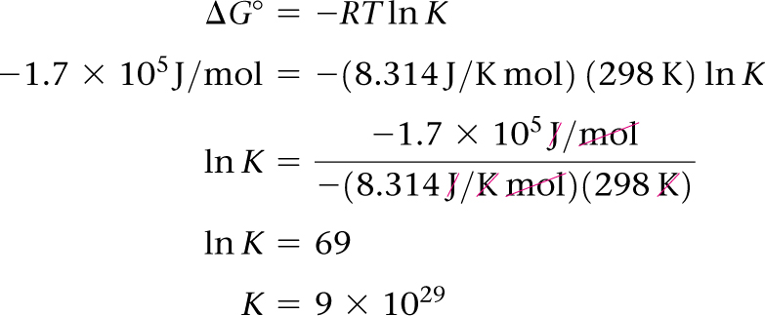
Sample Exercise 20.10 Using Standard Reduction Potentials to Calculate ΔG° and K
Continued
Now we need to calculate the equilibrium constant, K, using ΔG° = RT ln K. Because ΔG° is a large negative number, which means the reaction is thermodynamically very favorable, we expect K to be large.
(b) The overall equation is the same as that in part (a), multiplied by . The half-reactions are:
Reduction: O₂(g) + 2 H⁺(aq) + 2 e– H₂O(l) E°_{red} = +1.23 V
Oxidation: 2 Ag(s) 2 Ag⁺(aq) + 2 e– E°_{red} = +0.80 V
The values of E°_{red} are the same as they were in part (a); they are not changed by multiplying the half-reactions by . Thus, E° has the same value as in part (a): E° = +0.43 V. Notice, though, that the value of n has changed to n = 2, which is one-half the value in part (a). Thus, ΔG° is half as large as in part (a):

Slide 31
Sample Exercise 20.10 Using Standard Reduction Potentials to Calculate ΔG° and K
Continued
The value of ΔG° is half that in part (a) because the coefficients in the chemical equation are half those in (a).
Now we can calculate K as before:
–8.3 × 10⁴ J/mol = –(8.314 J/K mol)(298 K) ln K
K = 4 × 10¹⁴
Comment E° is an intensive quantity, so multiplying a chemical equation by a certain factor will not affect the value of E°. Multiplying an equation will change the value of n, however, and hence the value of ΔG°. The change in free energy, in units of J/mol of reaction as written, is an extensive quantity. The equilibrium constant is also an extensive quantity.
Practice Exercise 1
For the reaction
3 Ni²⁺(aq) + 2 Cr(OH)₃(s) + 10 OH–(aq) 3 Ni(s) + 2 CrO₄^{2–}(aq) + 8 H₂O(l)

Slide 32
Sample Exercise 20.10 Using Standard Reduction Potentials to Calculate ΔG° and K
Continued
ΔG° = +87 kJ/mol. Given the standard reduction potential of Ni²⁺(aq) in Table 20.1, what value do you calculate for the standard reduction potential of the half-reaction
CrO₄^{2–}(aq) + 4 H₂O(l) + 3 e– Cr(OH)₃(s) + 5 OH–(aq)?
(a) –0.43 V (b) –0.28 V (c) 0.02 V (d) –0.13 V (e) –0.15 V
Practice Exercise 2
Consider the reaction 2 Ag⁺(aq) + H₂(g) 2 Ag(s) + 2 H⁺(aq). Calculate for the Ag⁺(aq) ion from the standard reduction potentials in Table 20.1 and the fact that for H₂(g), Ag(s), and H⁺(aq) are all zero. Compare your answer with the value given in Appendix C.

Slide 33
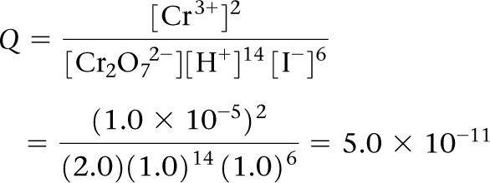
Sample Exercise 20.11 Cell Potential under Nonstandard Conditions
Calculate the emf at 298 K generated by a voltaic cell in which the reaction is
Cr₂O₇^{2–}(aq) + 14 H⁺(aq) + 6 I–(aq) 2 Cr³⁺(aq) + 3 I₂(s) + 7 H₂O(l)
when
[Cr₂O₇^{2–}] = 2.0 M, [H⁺] = 1.0 M, [I–] = 1.0 M, and [Cr³⁺] = 1.0 × 10^{–5} M
Solution
Analyze We are given a chemical equation for a voltaic cell and the concentrations of reactants and products under which it operates. We are asked to calculate the emf of the cell under these nonstandard conditions.
Plan To calculate the emf of a cell under nonstandard conditions, we use the Nernst equation in the form of Equation 20.18.
Solve
We calculate E° for the cell from standard reduction potentials (Table 20.1 or Appendix E). The standard emf for this reaction was calculated in Sample Exercise 20.6: E° = 0.79 V. As that exercise shows, six electrons are transferred from reducing agent to oxidizing agent, so n = 6. The reaction quotient, Q, is:

Slide 34
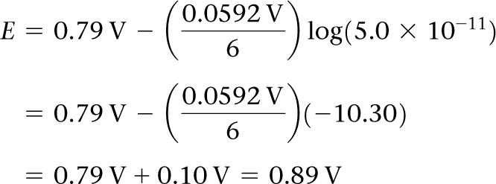
Sample Exercise 20.11 Cell Potential under Nonstandard Conditions
Continued
Using Equation 20.18, we have:
Check This result is qualitatively what we expect: Because the concentration of Cr₂O₇^{2–} (a reactant) is greater than 1 M and the concentration of Cr³⁺ (a product) is less than 1 M, the emf is greater than E°. Because Q is about 10^{–10}, log Q is about –10. Thus, the correction to E° is about 0.06 × 10/6, which is 0.1, in agreement with the more detailed calculation.
Practice Exercise 1
Consider a voltaic cell whose overall reaction is Pb²⁺(aq) + Zn(s) Pb(s) + Zn²⁺(aq). What is the emf generated by this voltaic cell when the ion concentrations are [Pb²⁺] = 1.5 × 10^{–3} M and [Zn²⁺] = 0.55 M?
(a) 0.71 V (b) 0.56 V (c) 0.49 V (d) 0.79 V (e) 0.64 V
Practice Exercise 2
For the Zn–Cu voltaic cell depicted in Figure 20.5, would the emf increase, decrease, or stay the same, if you increased the Cu²⁺(aq) concentration by adding CuSO₄ • 5H₂O to the cathode compartment?

Slide 35
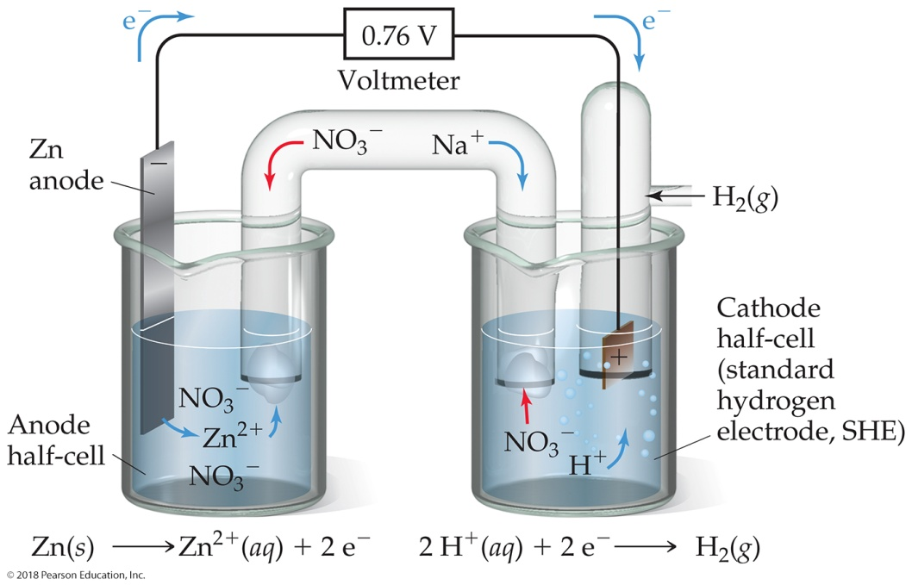
Sample Exercise 20.12 Calculating Concentrations in a Voltaic Cell
If the potential of a Zn–H₂ cell (like that in Figure 20.9) is 0.45 V at 25 °C when [Zn²⁺] = 1.0 M and P_{H2} = 1.0 atm, what is the pH of the cathode solution?
Solution
Analyze We are given a description of a voltaic cell, its emf, the concentration of Zn²⁺, and the partial pressure of H₂ (both products in the cell reaction). We are asked to calculate the pH of the cathode solution, which we can calculate from the concentration of H⁺, a reactant.
Plan We write the equation for the cell reaction and use standard reduction potentials to calculate E° for the reaction. After determining the value of n from our reaction equation, we solve the Nernst equation, Equation 20.18, for Q. We use the equation for the cell reaction to write an expression for Q that contains [H⁺] to determine [H⁺]. Finally, we use [H⁺] to calculate pH.

Slide 36
Sample Exercise 20.12 Calculating Concentrations in a Voltaic Cell
Continued
Solve
The cell reaction is: Zn(s) + 2 H⁺(aq) Zn²⁺(aq) + H₂(g)
The standard emf is: E° = E°_{red} (reduction) – E°_{red} (oxidation)
= 0 V – (–0.76 V) = +0.76 V
Because each Zn atom loses two electrons, n = 2
Using Equation 20.18, we can solve for Q:
Q has the form of the equilibrium constant for the reaction:
Solving for [H⁺], we have:
Finally, we use [H⁺] to calculate the pH of the cathode solution.
pH = log [H⁺] = –log (6 × 10^{–6}) = 5.2

Slide 37
Sample Exercise 20.12 Calculating Concentrations in a Voltaic Cell
Continued
Comment A voltaic cell whose cell reaction involves H⁺ can be used to measure [H⁺] or pH. A pH meter is a specially designed voltaic cell with a voltmeter calibrated to read pH directly. (Section 16.4)
Practice Exercise 1
Consider a voltaic cell where the anode half-reaction is Zn(s) Zn²⁺(aq) + 2 e– and the cathode half-reaction is Sn²⁺(aq) + 2 e– Sn(s). What is the concentration of Sn²⁺ if Zn²⁺ is 2.5 × 10^{–3} M and the cell emf is 0.660 V? Use the reduction potentials in Appendix E that are reported to three significant figures. (a) 3.3 × 10^{–2} M (b) 1.9 × 10^{–4} M (c) 9.0 × 10^{–3} M (d) 6.9 × 10^{–4} M (e) 7.6 × 10^{–3} M
Practice Exercise 2
What is the pH of the solution in the cathode half-cell in Figure 20.9 when P_{H2} = 1.0 atm, [Zn²⁺] in the anode half-cell is 0.10 M, and the cell emf is 0.542 V?

Slide 38
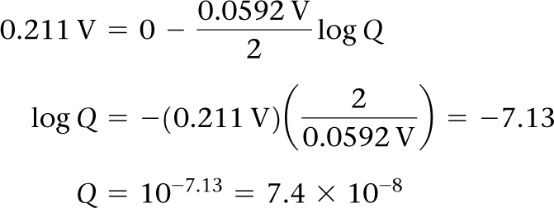
Sample Exercise 20.13 Determining pH Using a Concentration Cell
A voltaic cell is constructed with two hydrogen electrodes. Electrode 1 has P_{H2} = 1.00 atm and an unknown concentration of H⁺(aq). Electrode 2 is a standard hydrogen electrode (P_{H2} = 1.00 atm, [H⁺] = 1.00 M). At 298 K the measured cell potential is 0.211 V, and the electrical current is observed to flow from electrode 1 through the external circuit to electrode 2. What is the pH of the solution at electrode 1?
Solution
Analyze We are given the potential of a concentration cell and the direction in which the current flows. We also have the concentrations or partial pressures of all reactants and products except for [H⁺] in half-cell 1, which is our unknown.
Plan We can use the Nernst equation to determine Q and then use Q to calculate the unknown concentration. Because this is a concentration cell, E°_{cell} = 0 V.
Solve
Using the Nernst equation, we have:

Slide 39
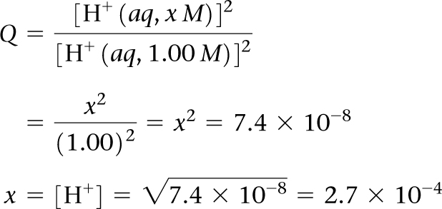
Sample Exercise 20.13 Determining pH Using a Concentration Cell
Continued
Because electrons flow from electrode 1 to electrode 2, electrode 1 is the anode of the cell and electrode 2 is the cathode. The electrode reactions are therefore as follows, with the concentration of H⁺(aq) in electrode 1 represented with the unknown x:
Thus,
At electrode 1, therefore, the pH of the solution is: pH = –log[H⁺] = –log(2.7 × 10^{–4}) = 3.57
Comment The concentration of H⁺ at electrode 1 is lower than that in electrode 2, which is why electrode 1 is the anode of the cell: The oxidation of H₂ to H⁺(aq) increases [H⁺] at electrode 1.

Slide 40
Sample Exercise 20.13 Determining pH Using a Concentration Cell
Continued
Practice Exercise 1
A concentration cell constructed from two hydrogen electrodes, both with P_{H2} = 1.00. One electrode is immersed in pure H₂O and the other in 6.0 M hydrochloric acid. What is the emf generated by the cell, and what is the identity of the electrode that is immersed in hydrochloric acid?
(a) –0.23 V, cathode
(b) 0.46 V, anode
(c) 0.023 V, anode
(d) 0.23 V, cathode
(e) 0.23 V, anode
Practice Exercise 2
A concentration cell is constructed with two Zn(s)–Zn²⁺(aq) half-cells. In one half-cell [Zn²⁺] = 1.35 M, and in the other [Zn²⁺] = 3.75 × 10^{–4} M. (a) Which half-cell is the anode? (b) What is the emf of the cell?

Slide 41
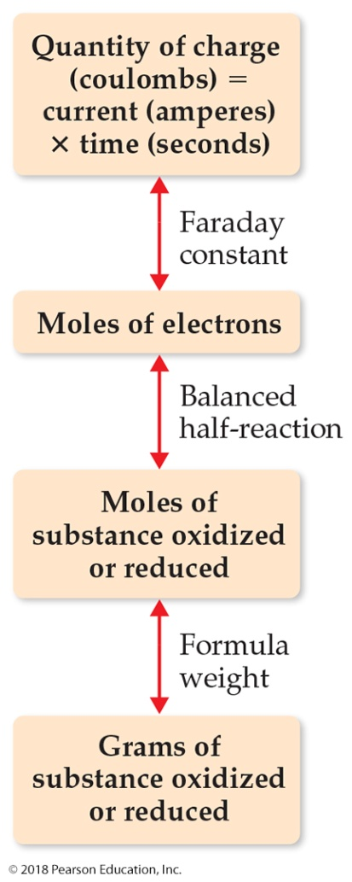
Sample Exercise 20.14 Relating Electrical Charge and Quantity of Electrolysis
Calculate the number of grams of aluminum produced in 1.00 h by the electrolysis of molten AlCl₃ if the electrical current is 10.0 A.
Solution
Analyze We are told that AlCl₃ is electrolyzed to form Al and asked to calculate the number of grams of Al produced in 1.00 h with 10.0 A.
Plan Figure 20.30 provides a roadmap for this problem. Using the current, time, a balanced half-reaction, and the atomic weight of aluminum we can calculate the mass of Al produced.
Solve
First, we calculate the coulombs of electrical charge passed into the electrolytic cell (note that 10.0 A = 10.0 C/s):
Second, we calculate the number of moles of electrons that pass into the cell:

Slide 42
Sample Exercise 20.14 Relating Electrical Charge and Quantity of Electrolysis
Continued
Third, we relate number of moles of electrons to number of moles of aluminum formed, using the half-reaction for the reduction of Al³⁺:
Al³⁺ + 3 e– Al
Thus, 3 mol of electrons are required to form 1 mol of Al:
Finally, we convert moles to grams:
Or, we could have combined all of the above steps:

Slide 43
Sample Exercise 20.14 Relating Electrical Charge and Quantity of Electrolysis
Continued
Practice Exercise 1
How much time is needed to deposit 1.0 g of chromium metal from an aqueous solution of CrCl₃ using a current of 1.5 A?
(a) 3.8 × 10^{–2} s (b) 21 min (c) 62 min (d) 139 min (e) 3.2 × 10³ min
Practice Exercise 2
(a) The half-reaction for formation of magnesium metal upon electrolysis of molten MgCl₂ is Mg²⁺ + 2 e– Mg.
Calculate the mass of magnesium formed upon passage of a current of 60.0 A for a period of 4.00 × 10³ s. (b) How many seconds would be required to produce 50.0 g of Mg from MgCl₂ if the current is 100.0 A?

Slide 44
Sample Integrative Exercise Putting Concepts Together
The K_{sp} at 298 K for iron(II) fluoride is 2.4 × 10^{–6}. (a) Write a half-reaction that gives the likely products of the two-electron reduction of FeF₂(s) in water. (b) Use the K_{sp} value and the standard reduction potential of Fe²⁺(aq) to calculate the standard reduction potential for the half-reaction in part (a). (c) Rationalize the difference between the reduction potential in part (a) and the reduction potential for Fe²⁺(aq).
Solution
Analyze We are going to combine what we know about equilibrium constants and electrochemistry to obtain reduction potentials.
Plan For (a) we need to determine which ion, Fe²⁺ or F–, is more likely to be reduced by two electrons and complete the overall reaction FeF₂ + 2 e– ?. For (b) we need to write the chemical equation associated with the K_{sp} and see how it relates to E° for the reduction half-reaction in (a). For (c) we need to compare E° from (b) with the value for the reduction of Fe²⁺.
Solve
(a) Iron(II) fluoride is an ionic substance that consists of Fe²⁺ and F– ions. We are asked to predict where two electrons could be added to FeF₂. We cannot envision adding the electrons to the F– ions to form F^{2–}, so it seems likely that we could reduce the Fe²⁺ ions to Fe(s). We therefore predict the half-reaction:
FeF₂(s) + 2 e– Fe(s) + 2 F–(aq)

Slide 45
Sample Integrative Exercise Putting Concepts Together
Continued
(b) The K_{sp} for FeF₂ refers to the following equilibrium: (Section 17.4)
FeF₂(s) Fe²⁺(aq) + 2 F–(aq) K_{sp} = [Fe²⁺][F–]² = 2.4 × 10^{–6}
We were also asked to use the standard reduction potential of Fe²⁺, whose half-reaction and standard reduction potentials are listed in Appendix E:
Fe²⁺(aq) + 2 e– Fe(s) E = –0.440 V
According to Hess’s law, if we can add chemical equations to get a desired equation, then we can add their associated thermodynamic state functions, like ΔH or ΔG, to determine the thermodynamic quantity for the desired reaction. (Section 5.6) So we need to consider whether the three equations we are working with can be combined in a similar fashion. Notice that if we add the K_{sp} reaction to the standard reduction half-reaction for Fe²⁺, we get the half-reaction we want:
Reaction 3 is still a half-reaction, so we do see the free electrons.

Slide 46
Sample Integrative Exercise Putting Concepts Together
Continued
If we knew ΔG° for reactions 1 and 2, we could add them to get ΔG° for reaction 3. We can relate ΔG° to E° by ΔG° = –nFE° (Equation 20.12) and to K by ΔG° = –RT ln K (Equation 19.20; see also Figure 20.13). Furthermore, we know that K for reaction 1 is the K_{sp} of FeF₂, and we know E° for reaction 2. Therefore, we can calculate ΔG° for reactions 1 and 2:
(Recall that 1 volt is 1 joule per coulomb.)
Then ΔG° for reaction 3, the one we want, is the sum of the ΔG° values for reactions 1 and 2:
3.21 × 10⁴ J/mol + 8.49 × 10⁴ J/mol = 1.17 × 10⁵ J/mol
We can convert this to E° from the relationship ΔG° = –nFE°:

Slide 47
Sample Integrative Exercise Putting Concepts Together
Continued
(c) The standard reduction potential for FeF₂(–0.606 V) is more negative than that for Fe²⁺(–0.440 V), telling us that the reduction of FeF₂ is the less favorable process. When FeF₂ is reduced, we not only reduce the Fe²⁺ but also break up the ionic solid. Because this additional energy must be overcome, the reduction of FeF₂ is less favorable than the reduction of Fe²⁺.

